Slide 1

2010 Indoor Furniture Retailers’
Outdoor Programs
Showcase
Compiled by
August 2010

Slide 2








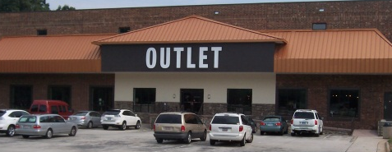
Click a logo to navigate directly to that Retailer

Slide 3
North Hollywood, CA

Slide 4
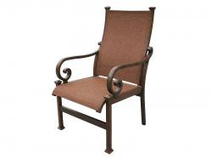
1301
Valario Sling Dining Chair- by Broyhill

Slide 5
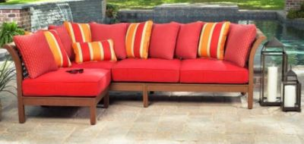
FI-CLSES-11
Lane Modular Sectional- by Lane Home Furnishings

Slide 7
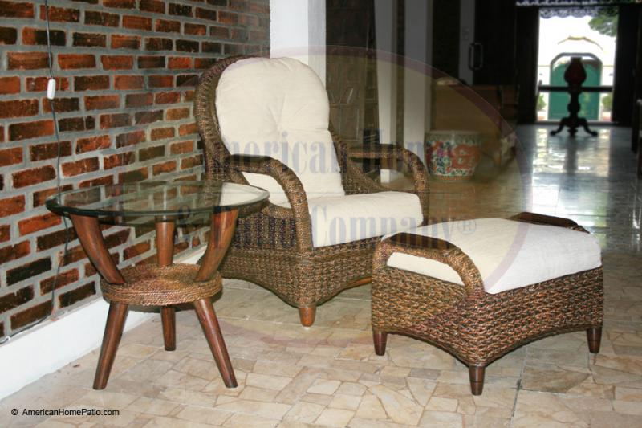

Slide 8
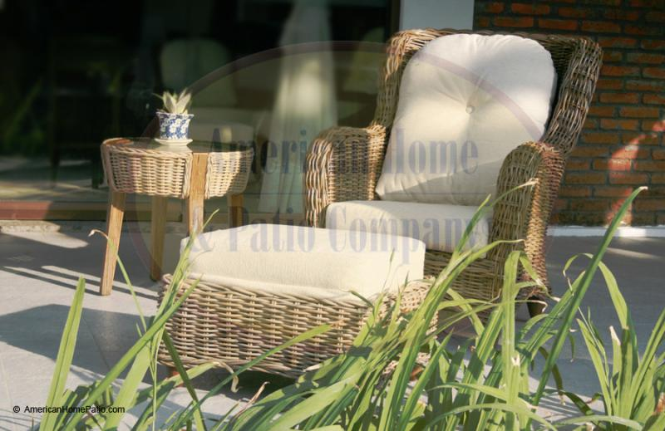

Slide 9
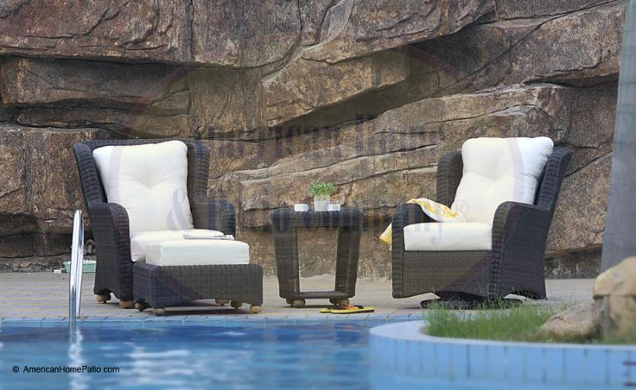

Slide 10
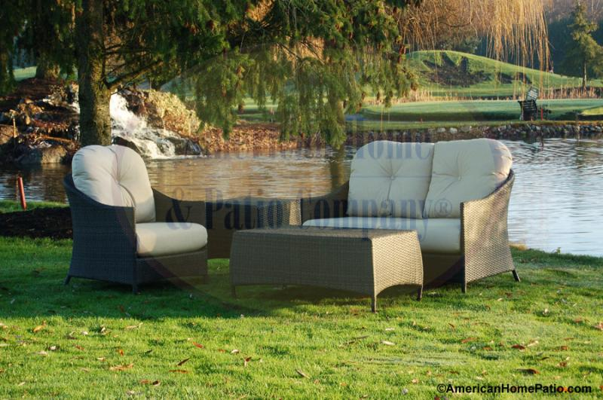

Slide 11
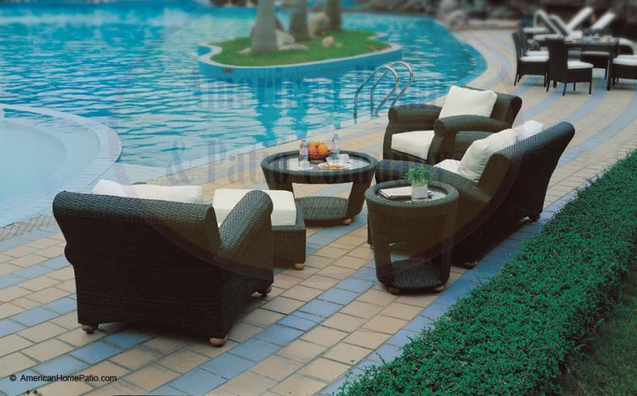

Slide 12
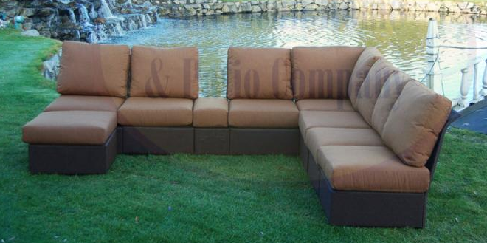

Slide 13
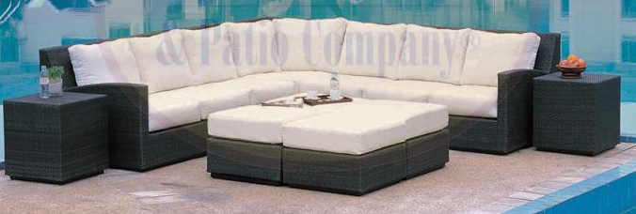

Slide 14
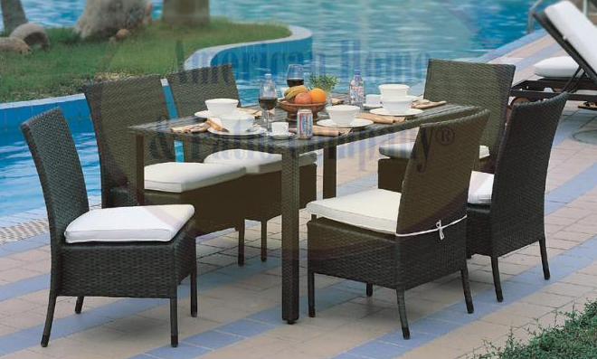

Slide 15
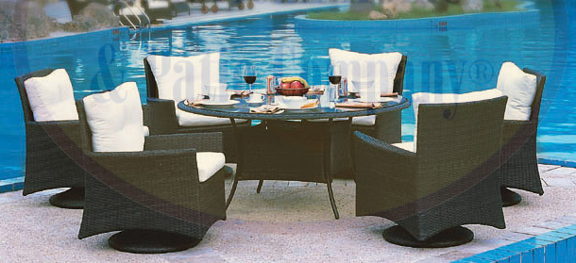

Slide 16
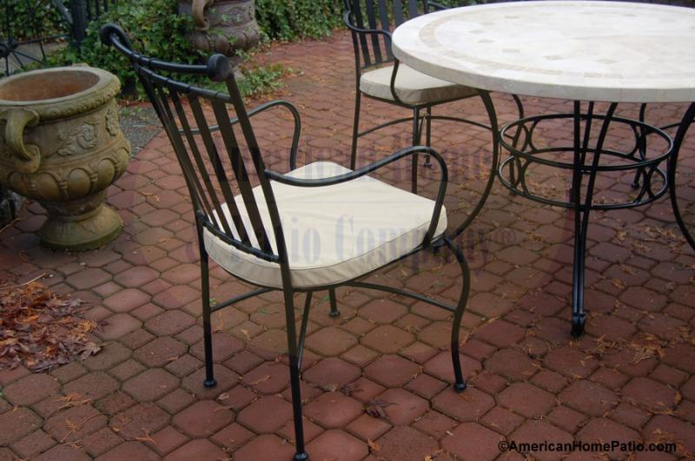

Slide 17
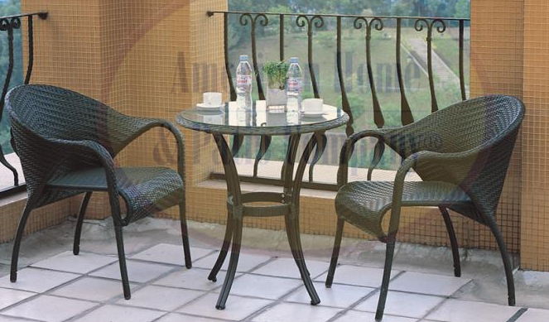

Slide 18
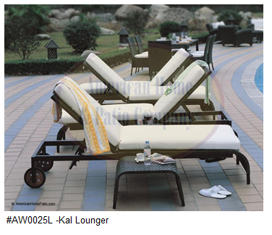

Slide 20
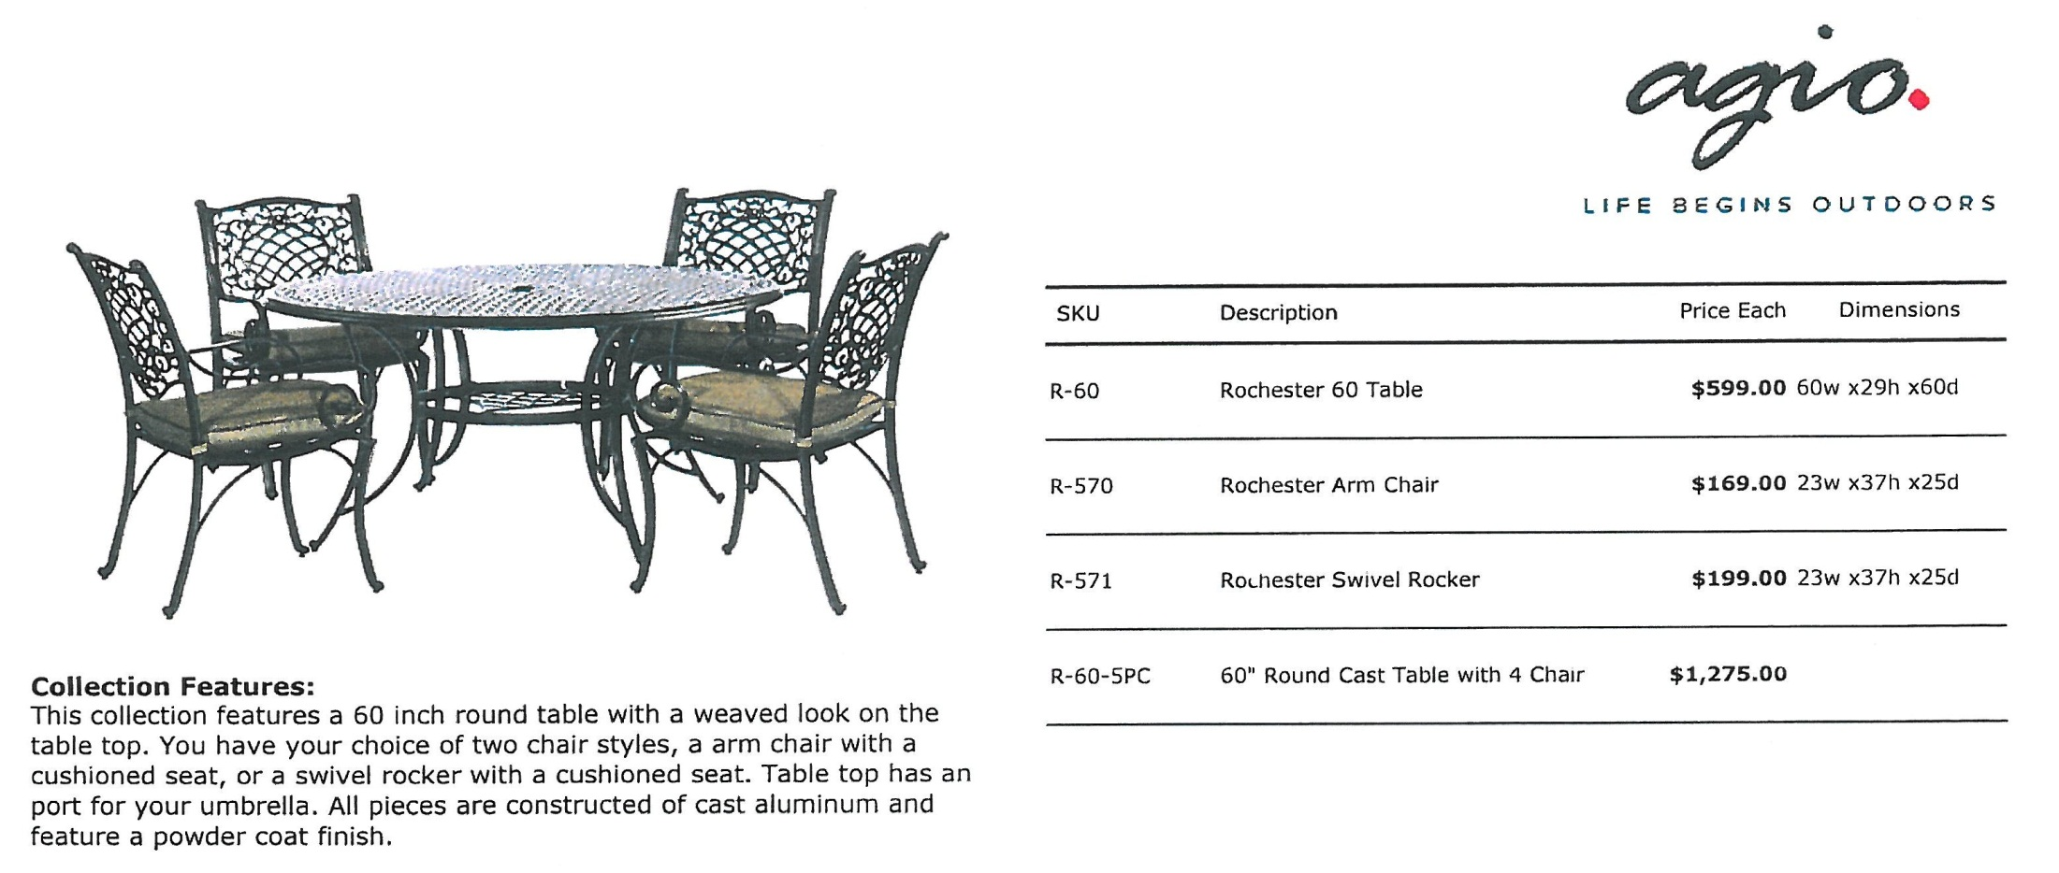

Slide 21
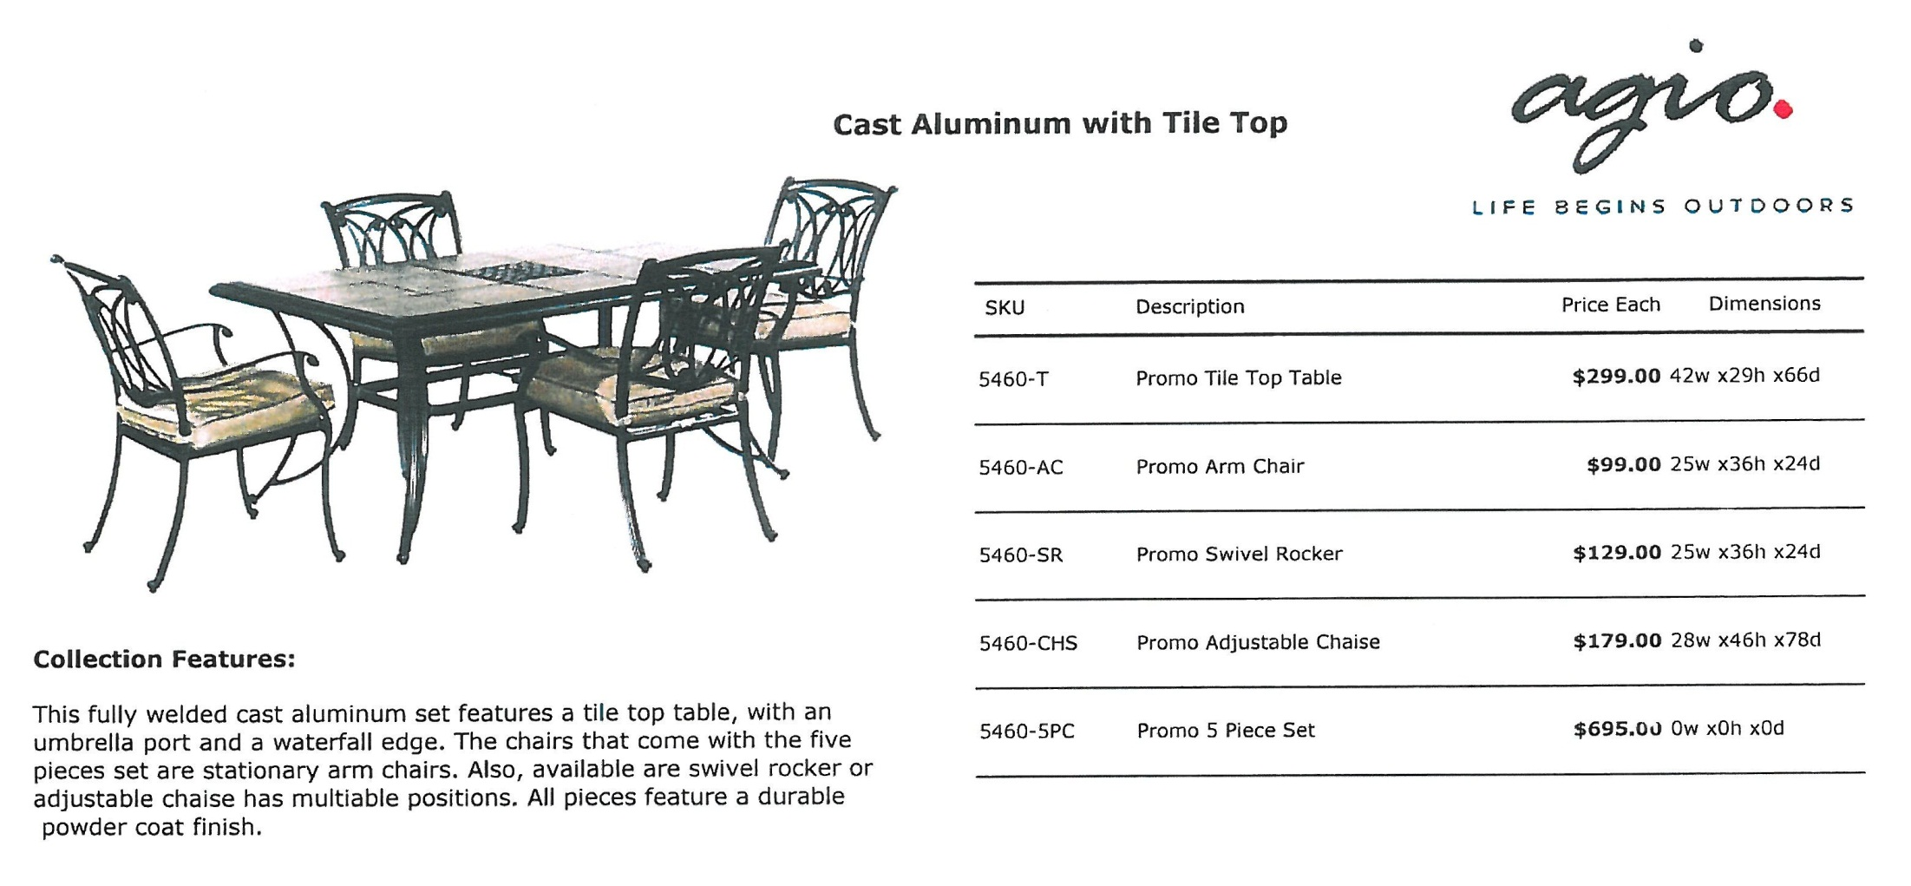

Slide 22
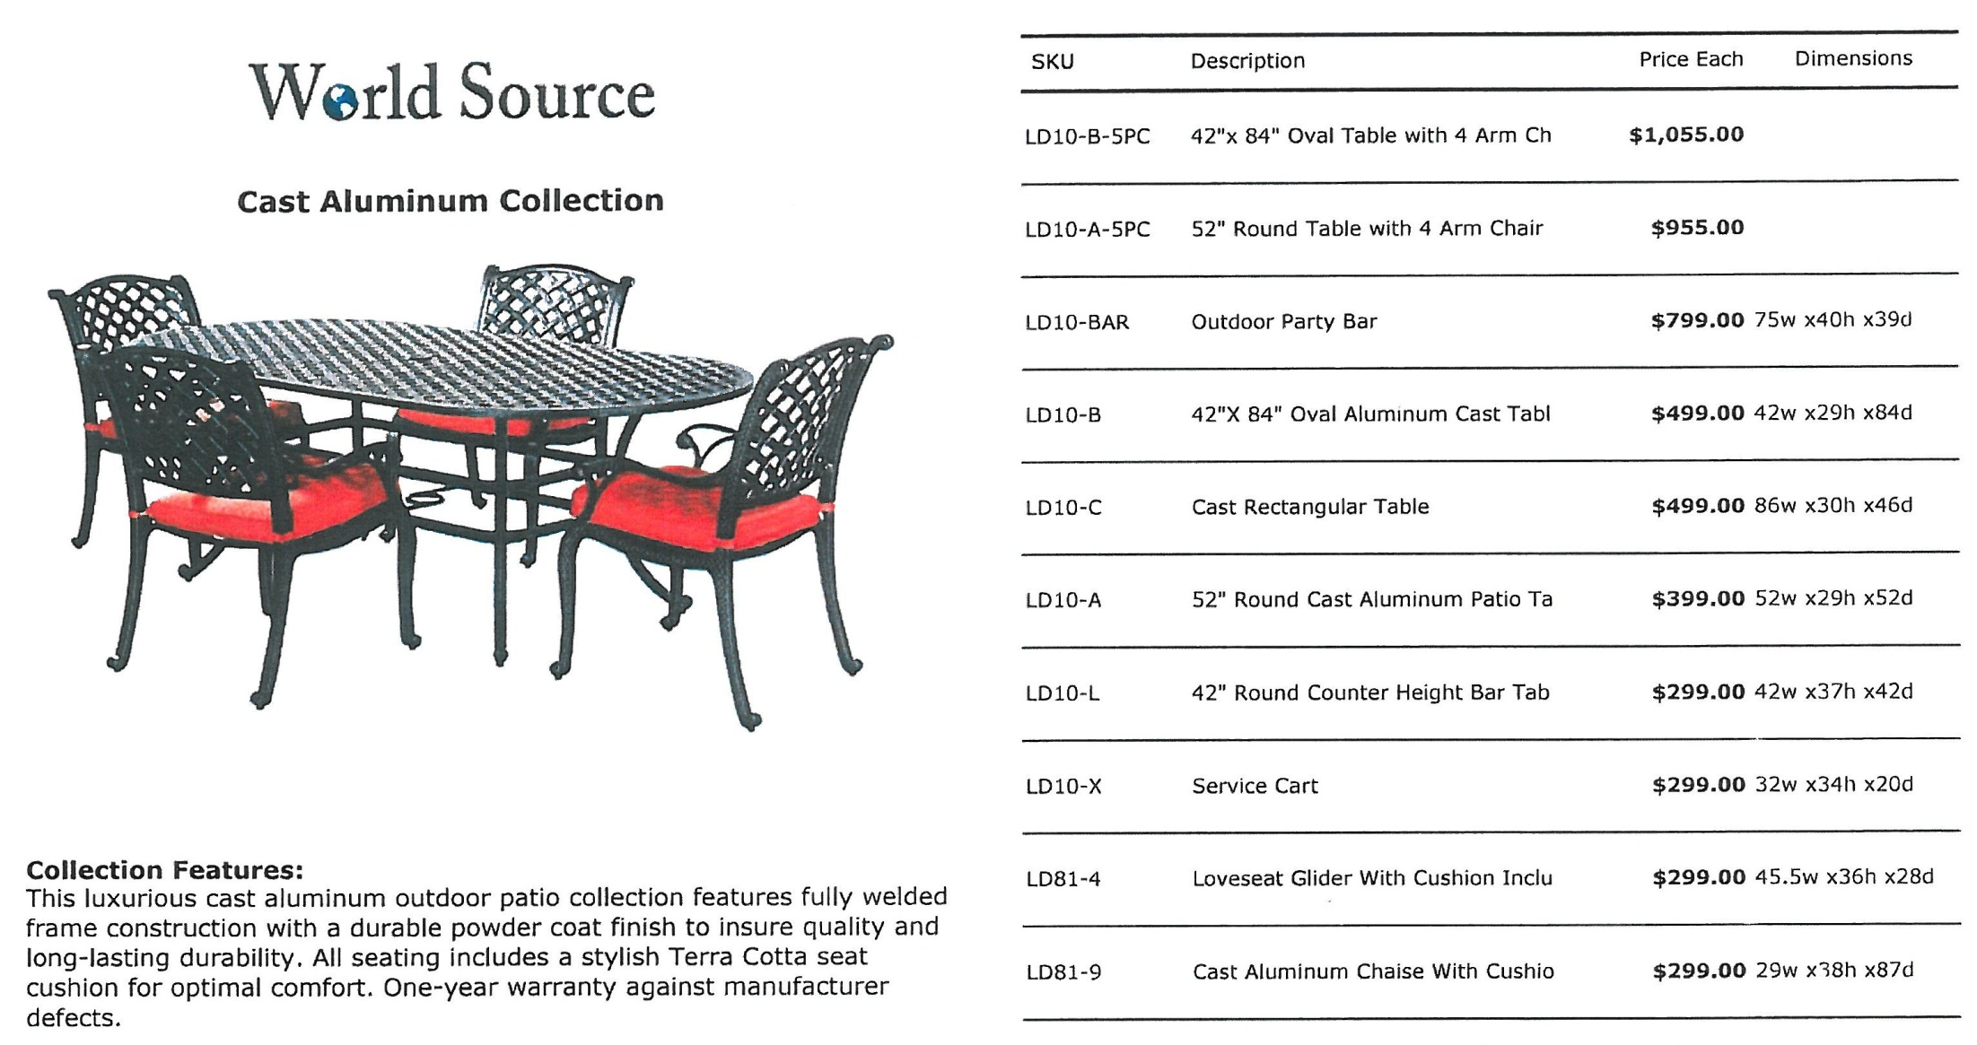
More items on the next slide >>>

Slide 23
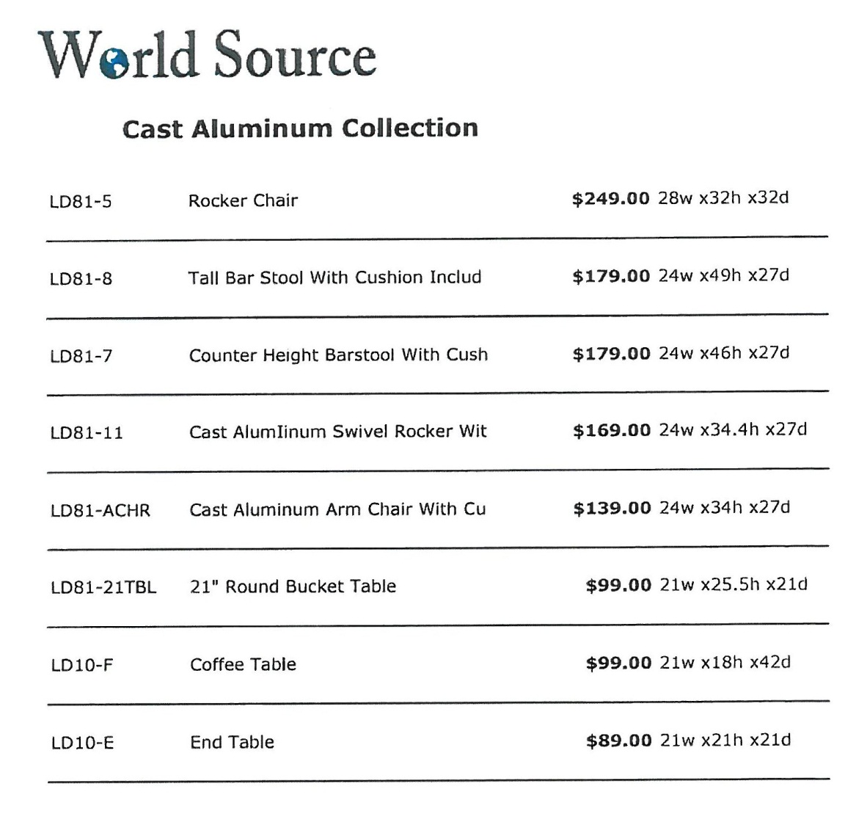

Slide 24
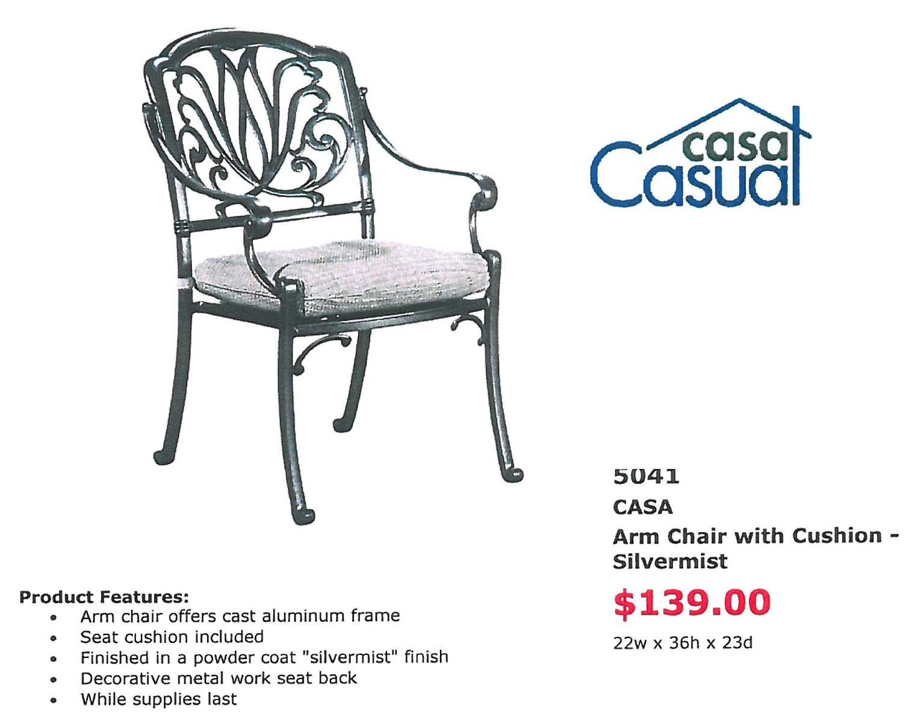

Slide 25
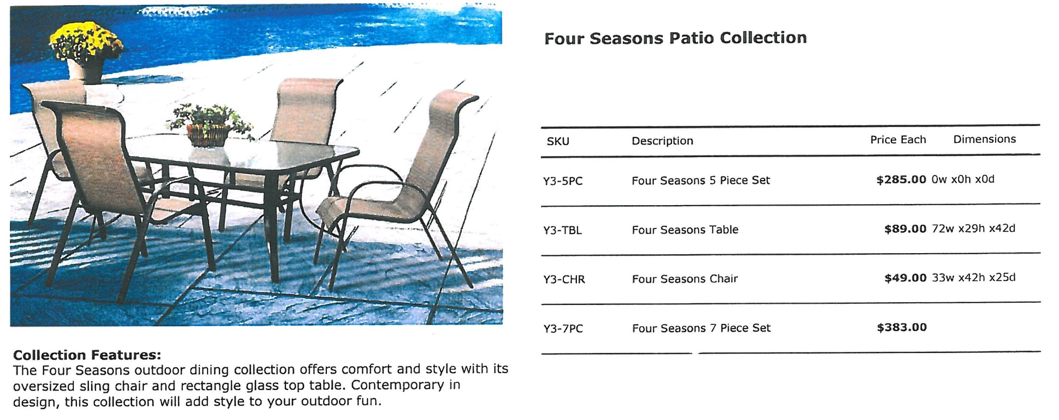

Slide 26
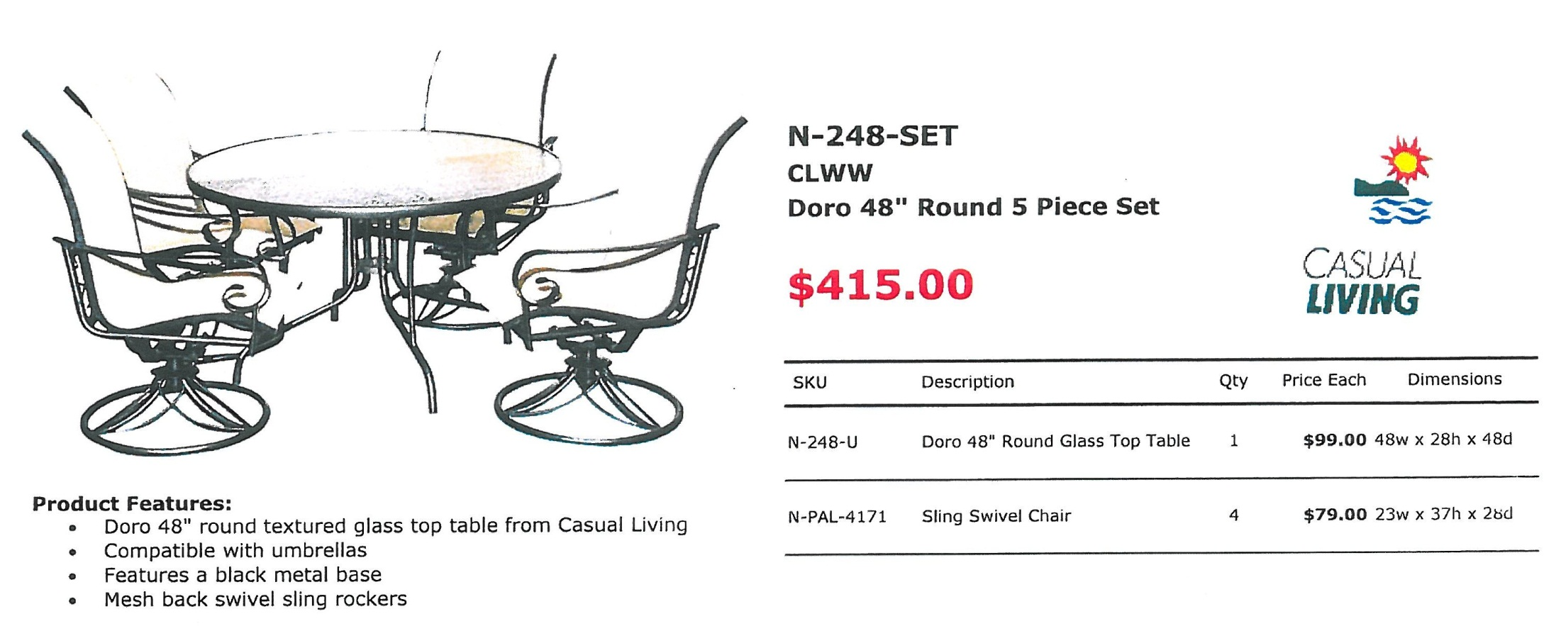

Slide 27
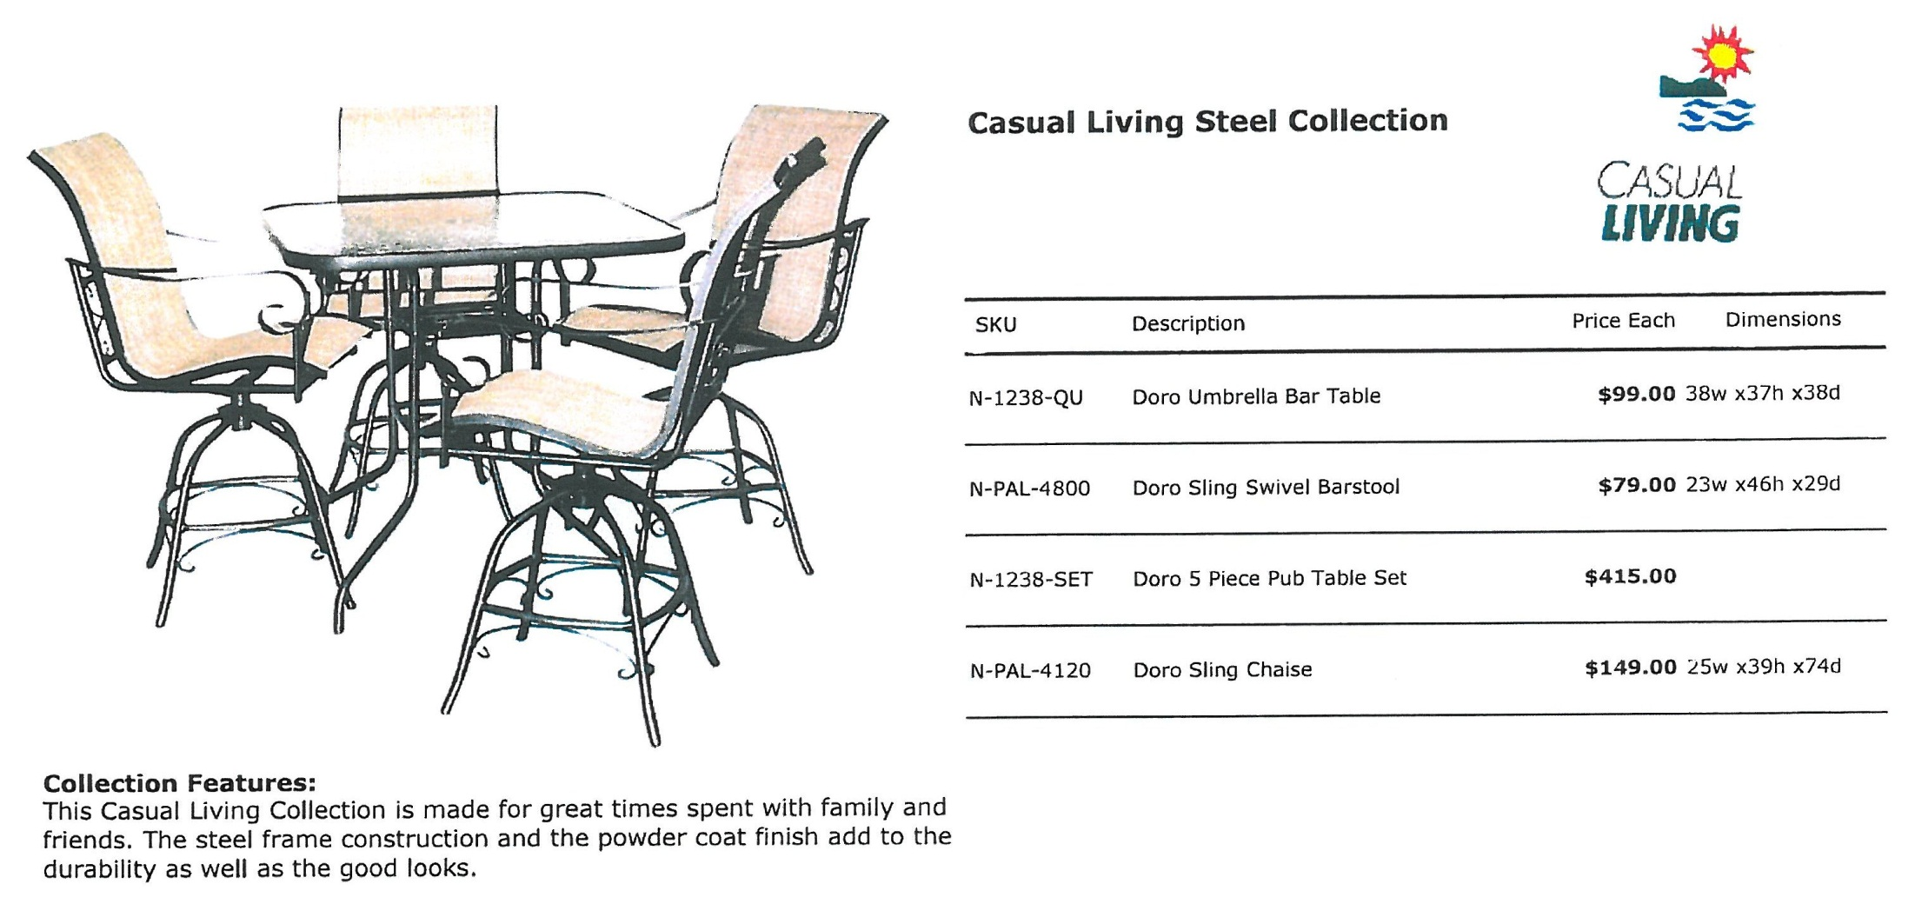

Slide 28
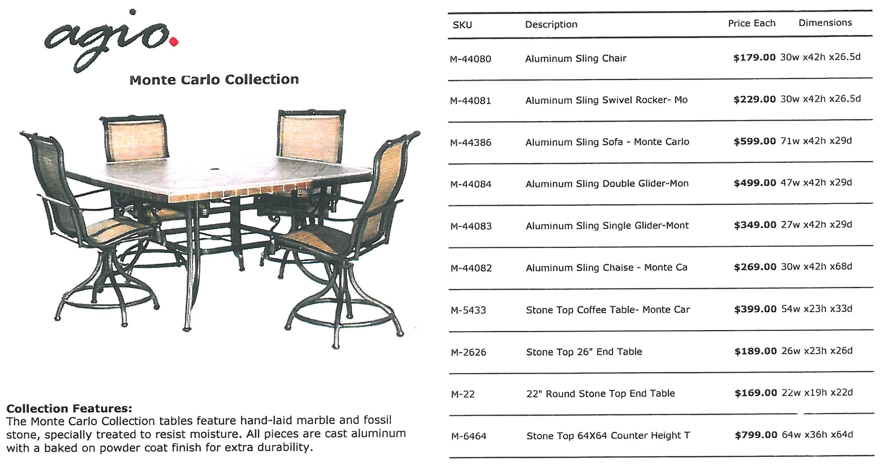
More items on the next slide >>>

Slide 29
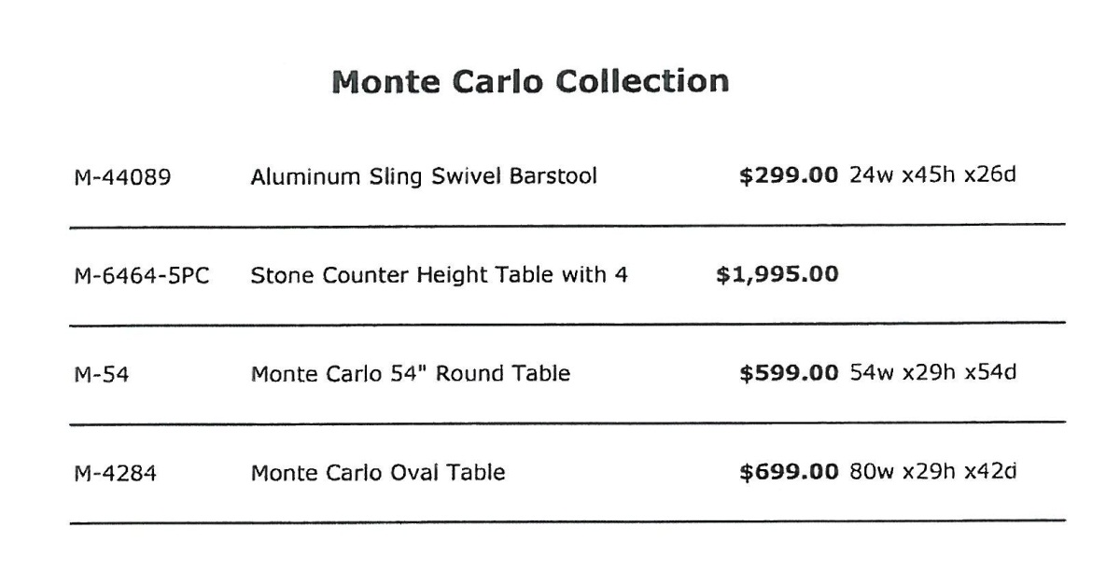

Slide 30
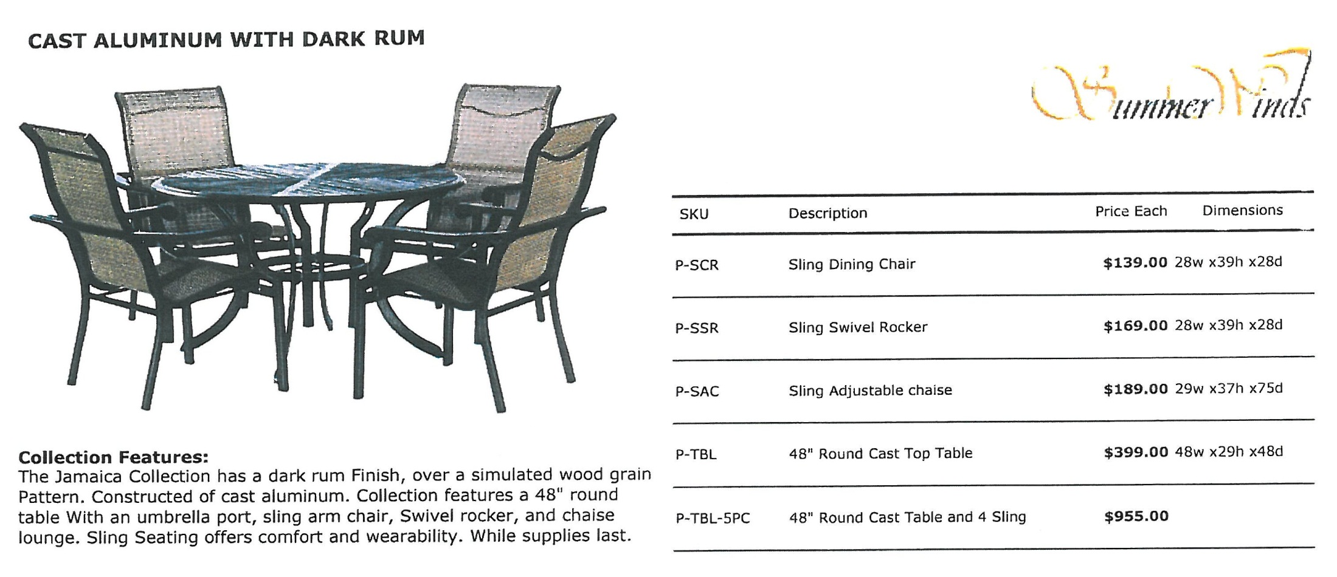

Slide 31
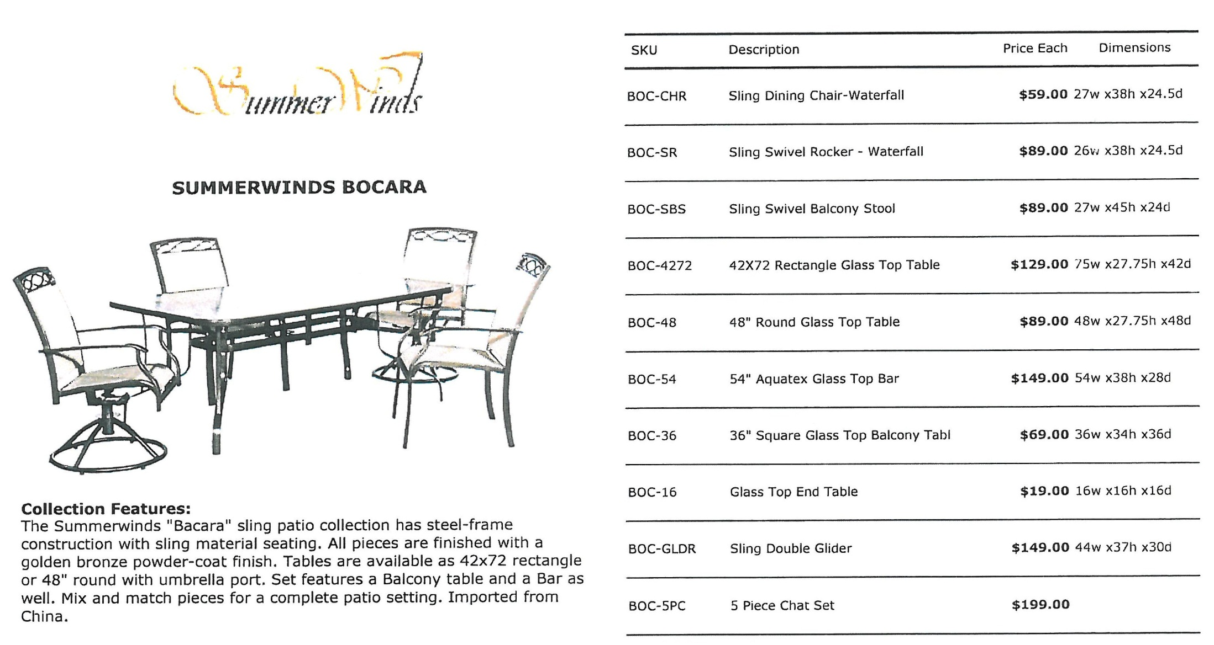

Slide 32
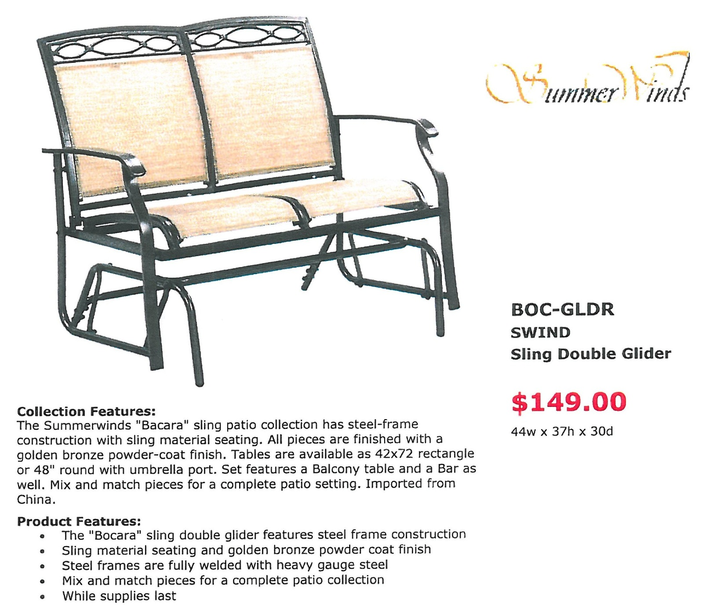

Slide 33
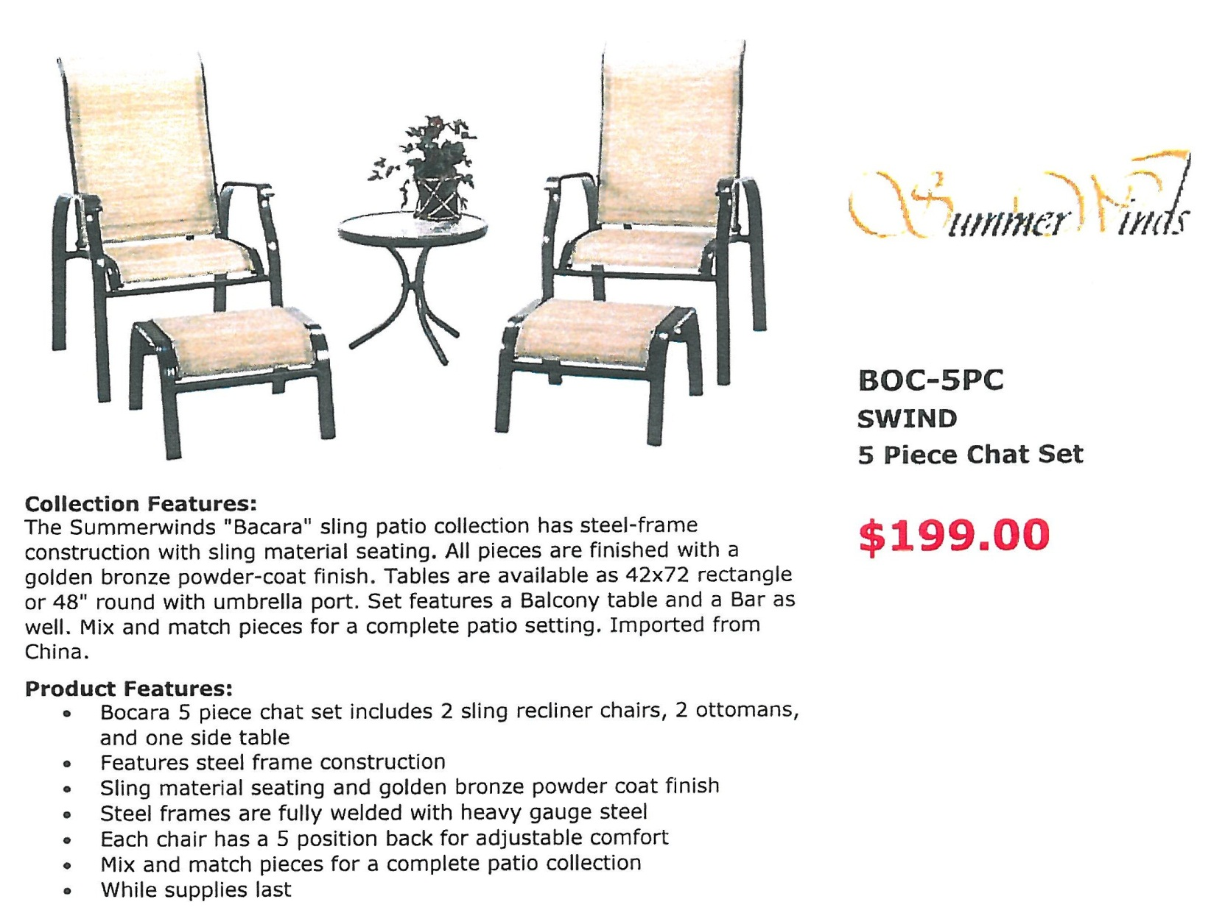

Slide 34
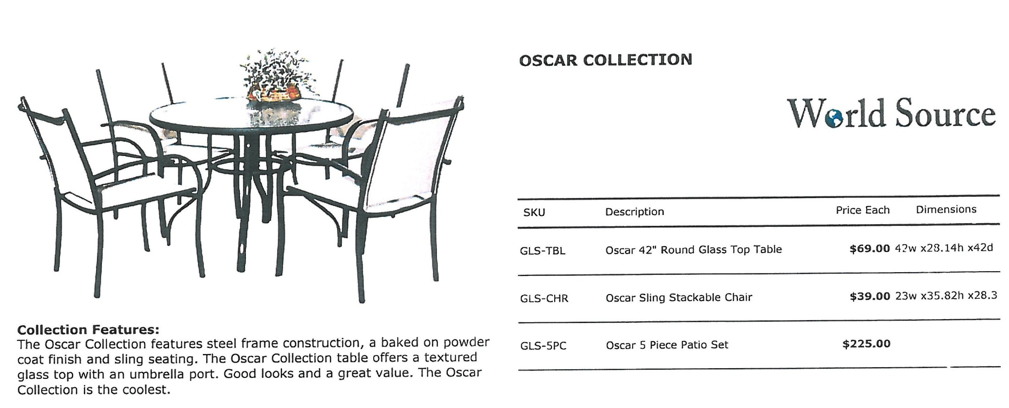

Slide 35
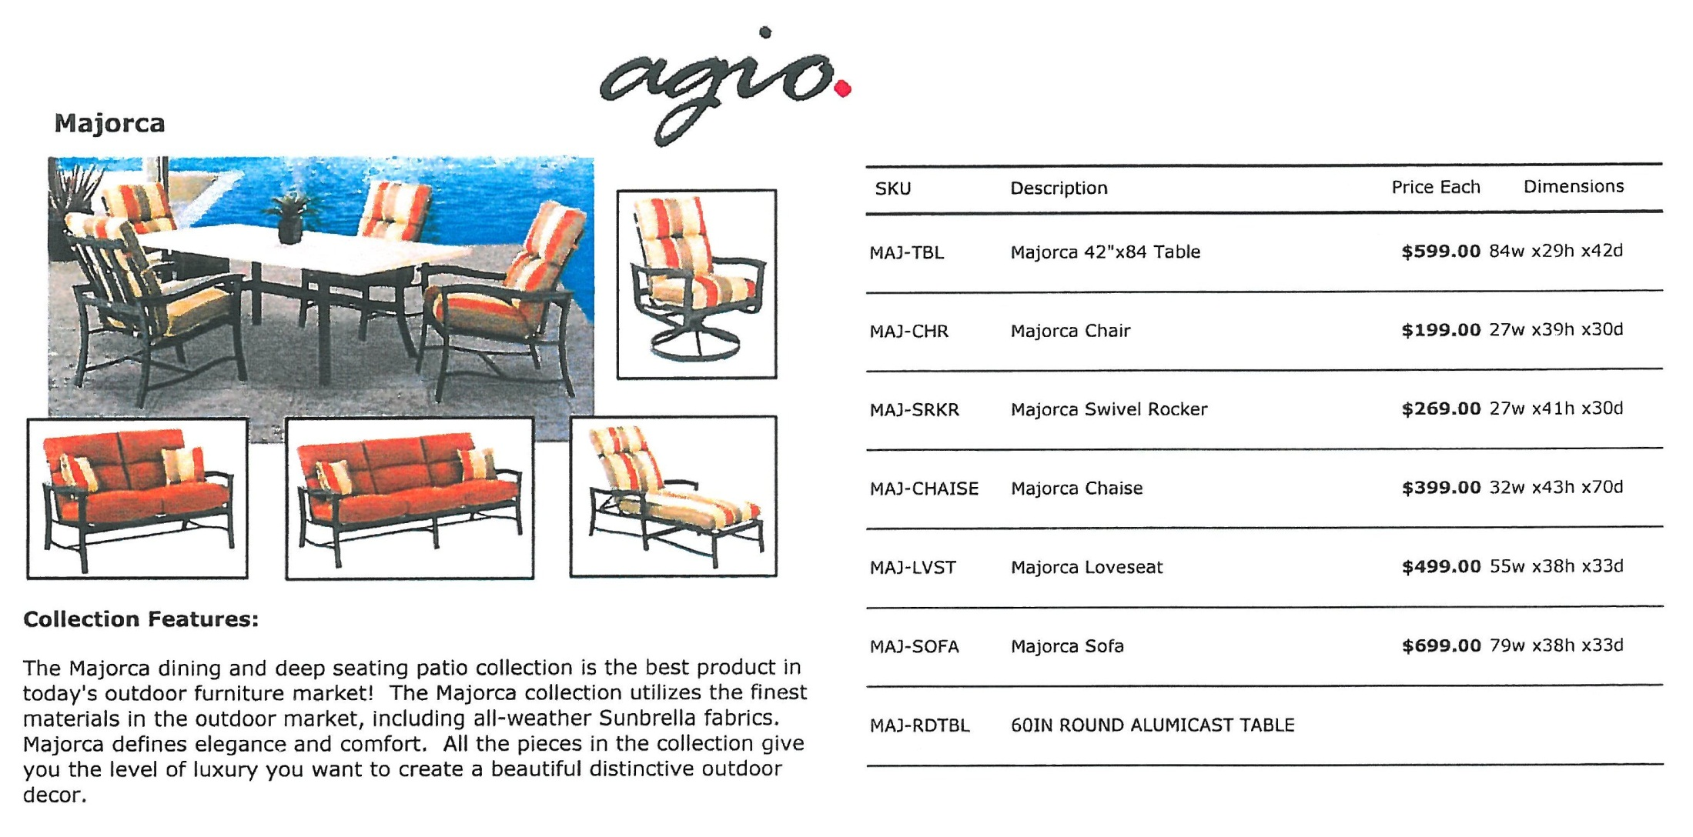

Slide 36
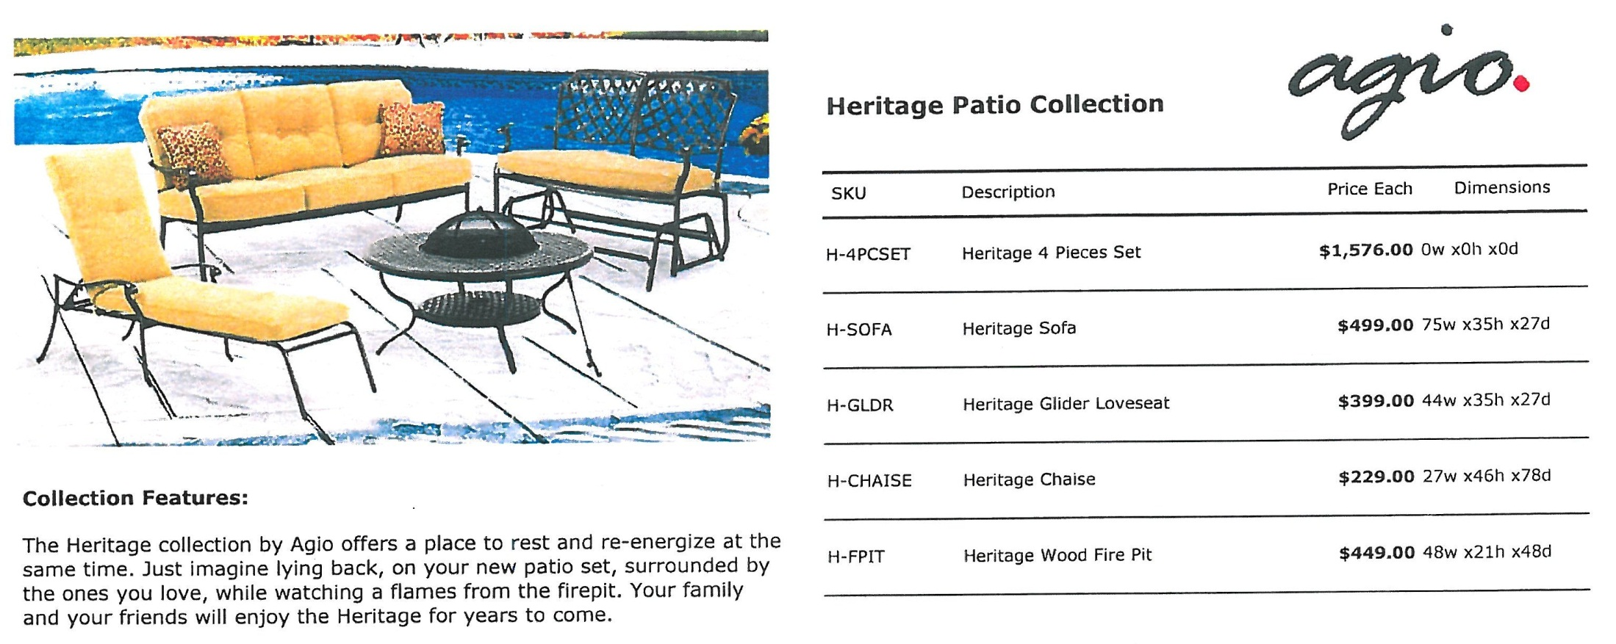

Slide 37
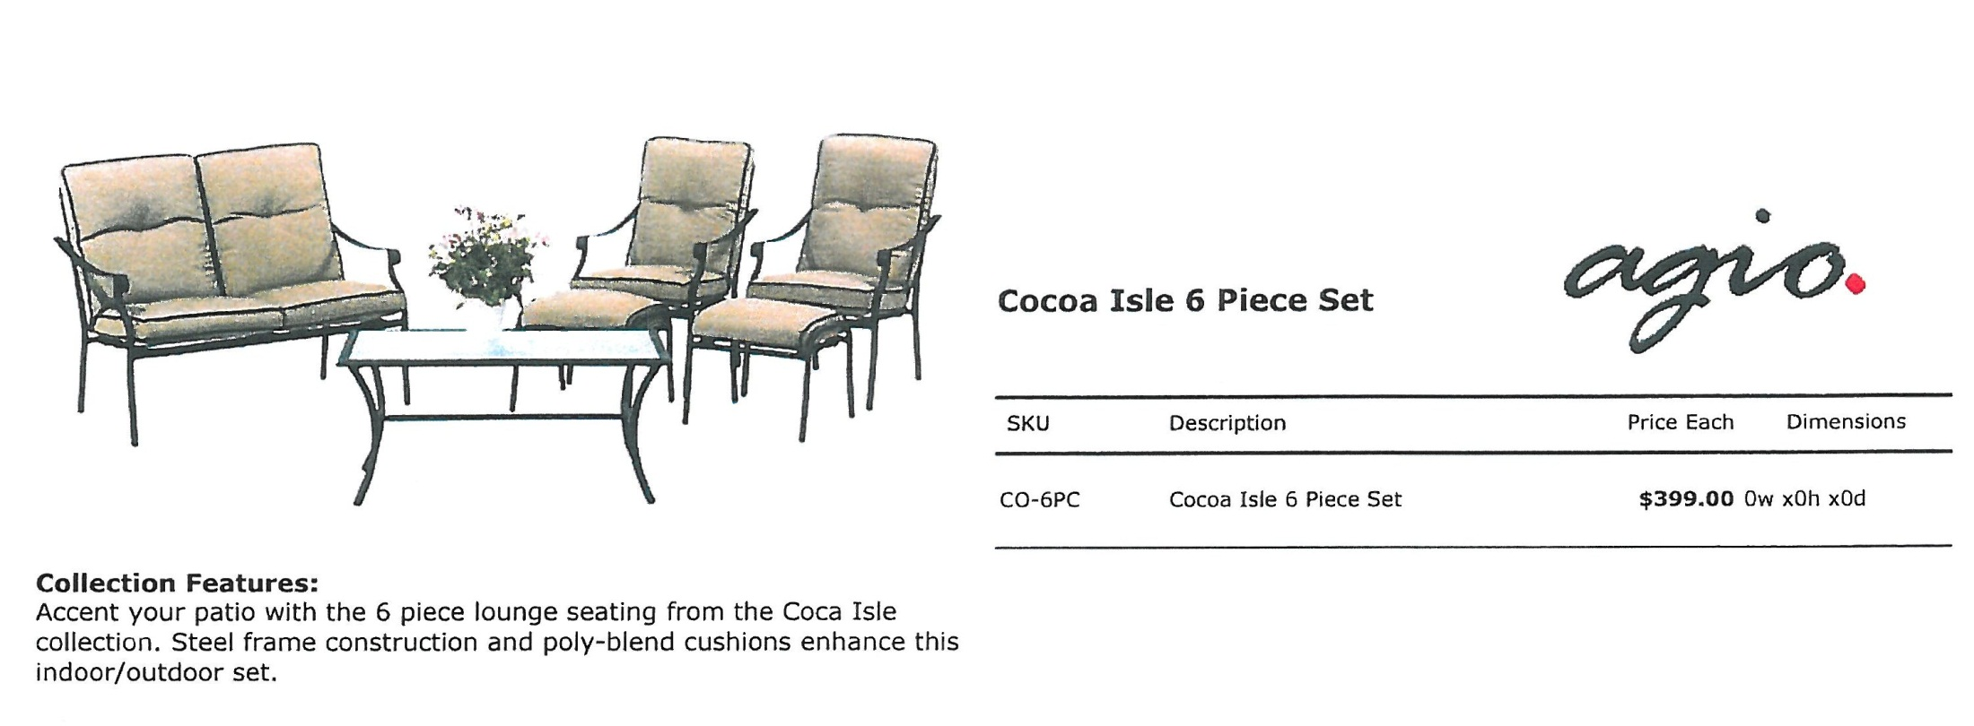

Slide 38
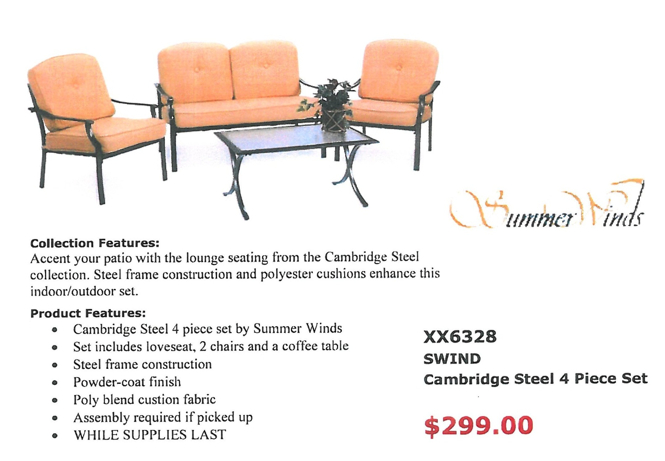

Slide 39
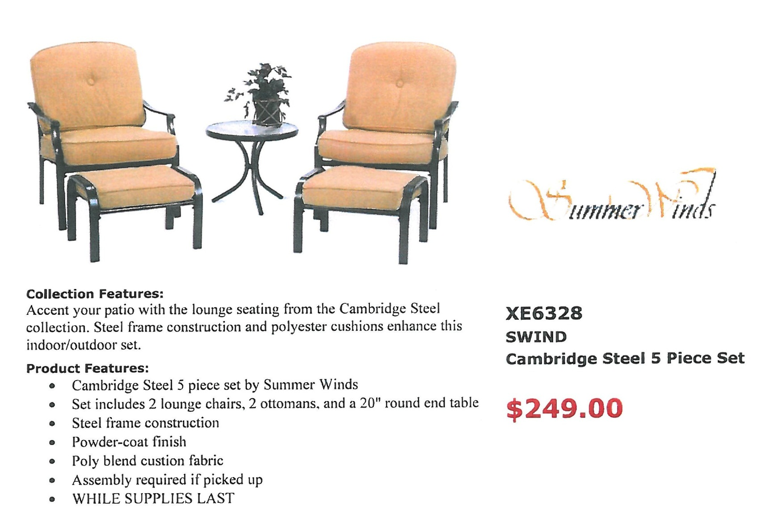

Slide 40
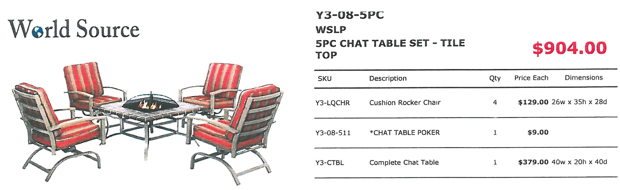

Slide 41
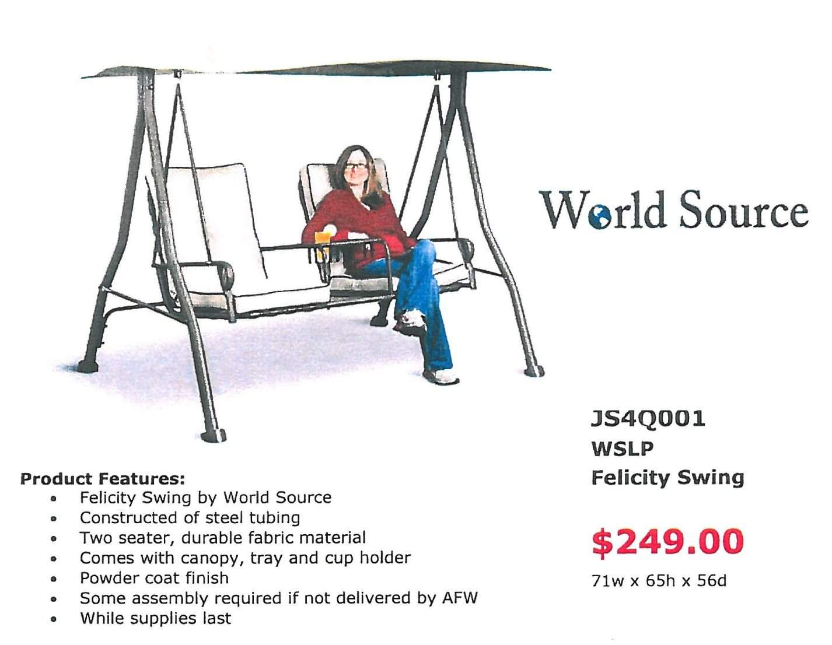

Slide 42
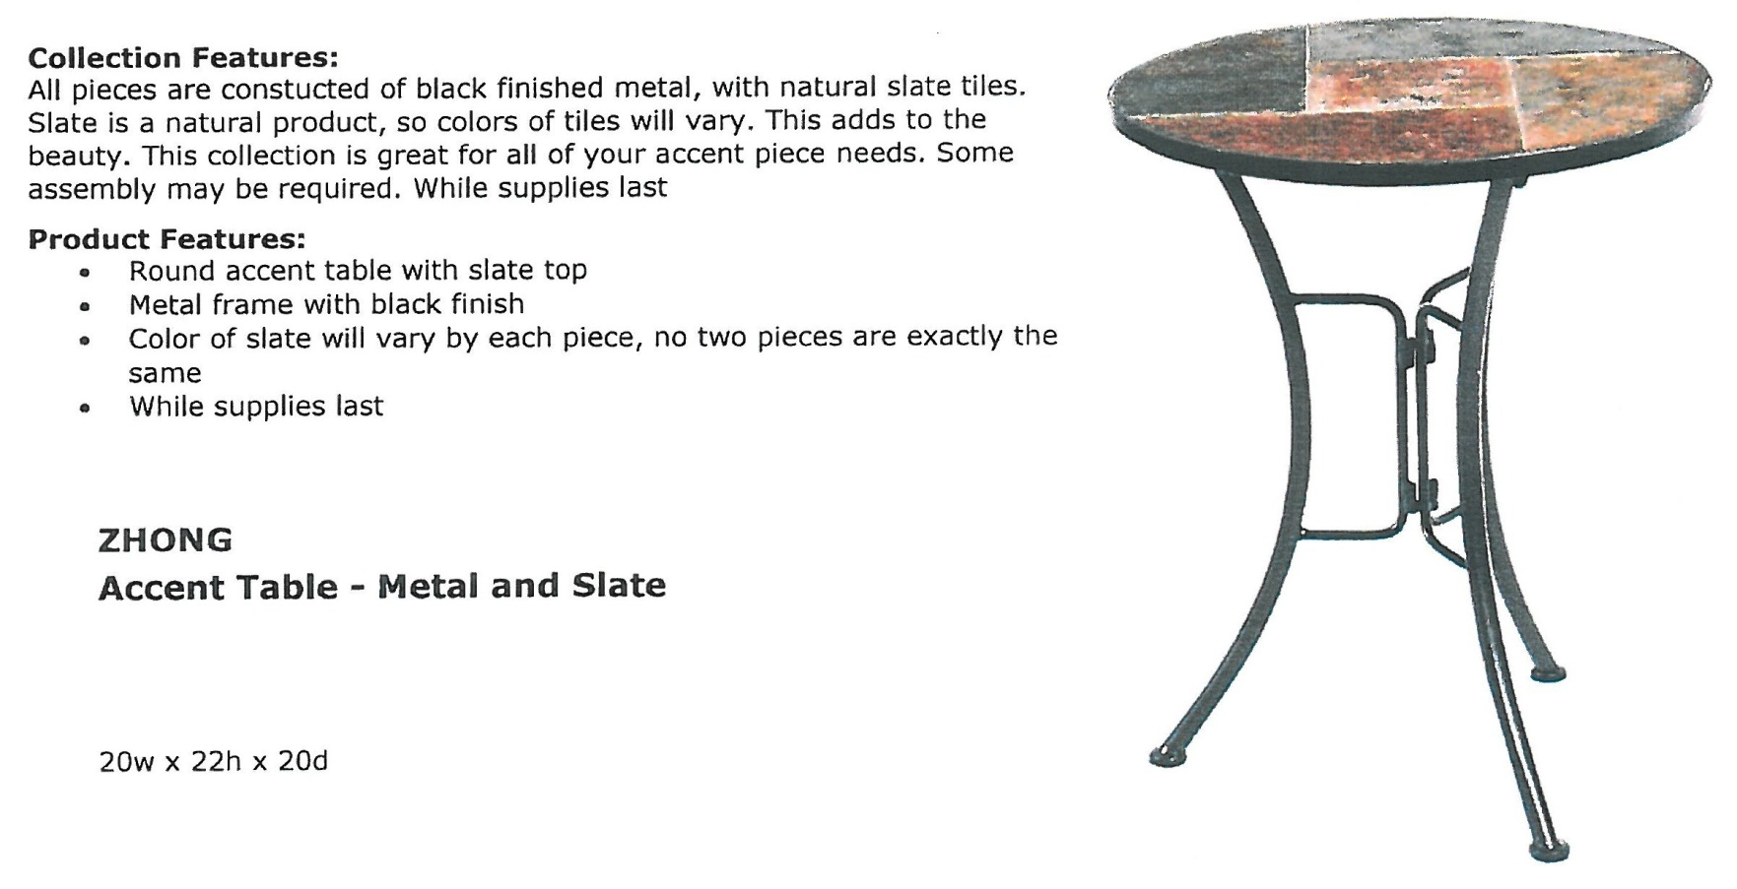

Slide 43
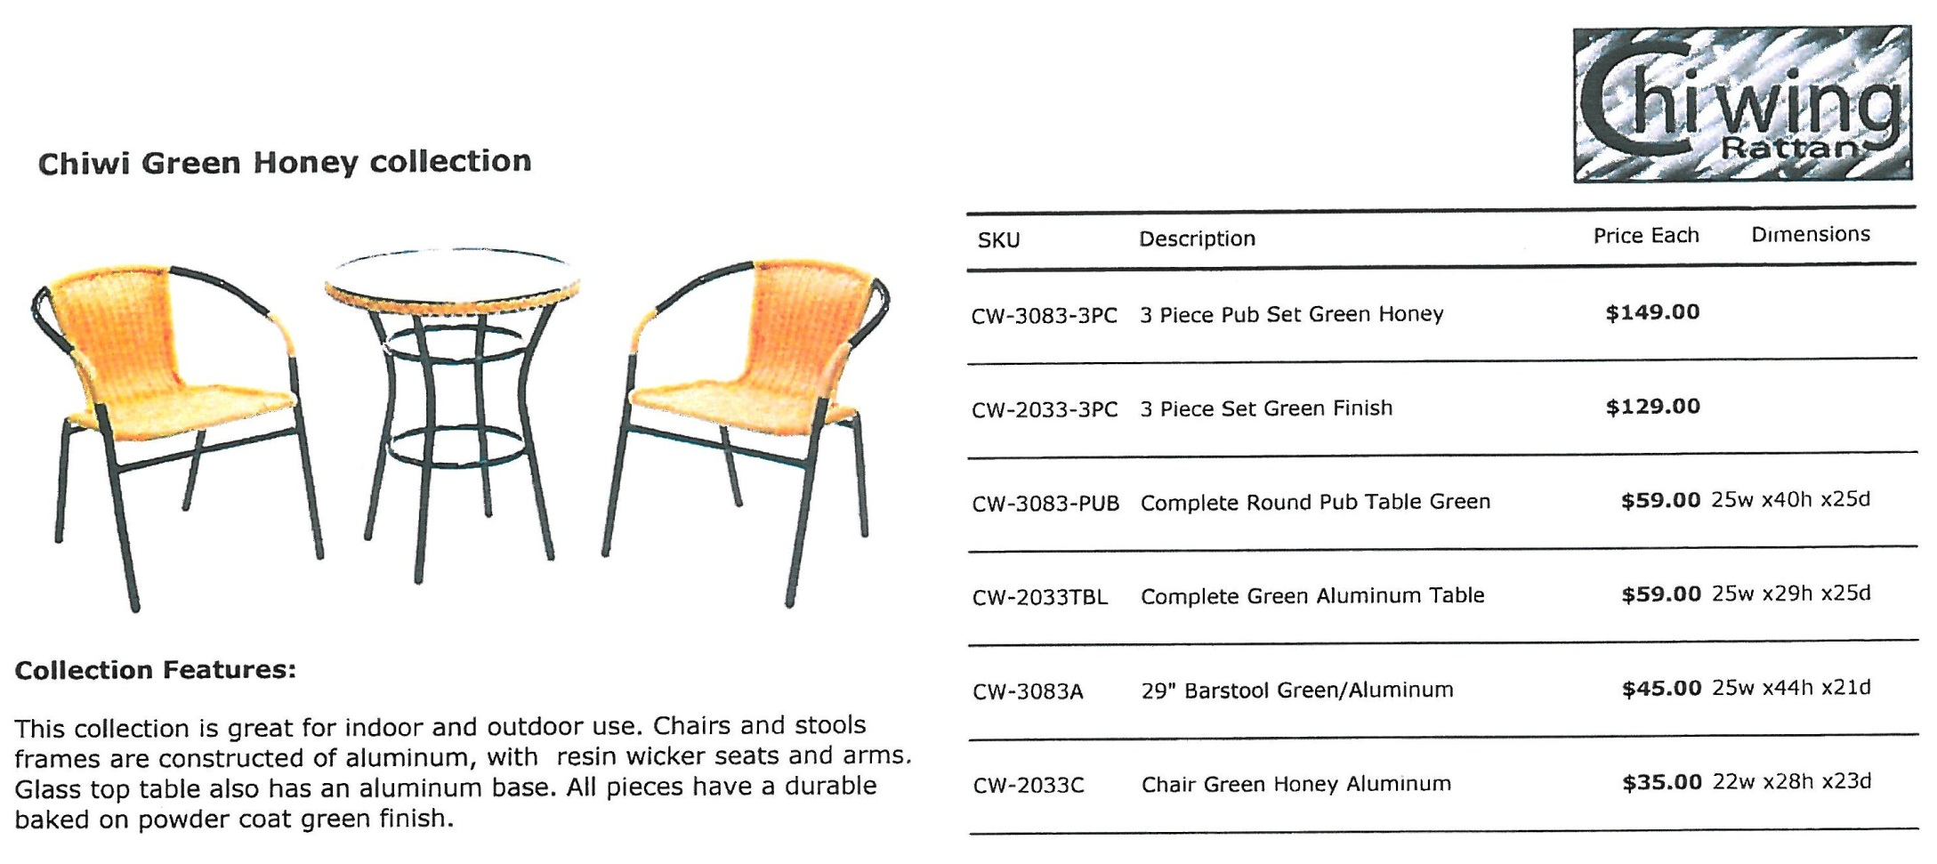

Slide 44
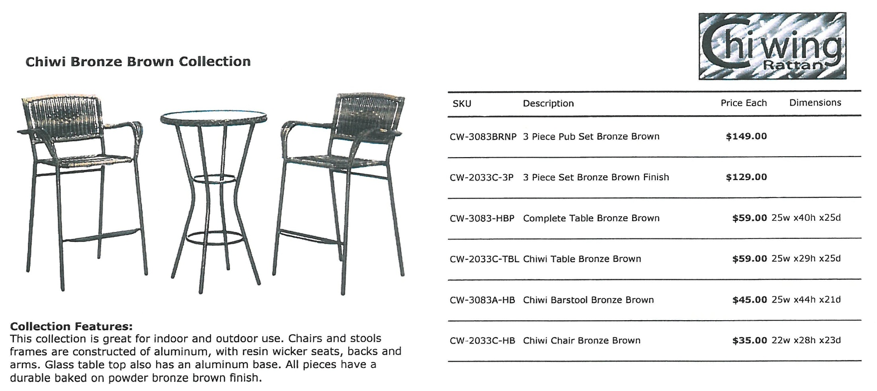

Slide 45
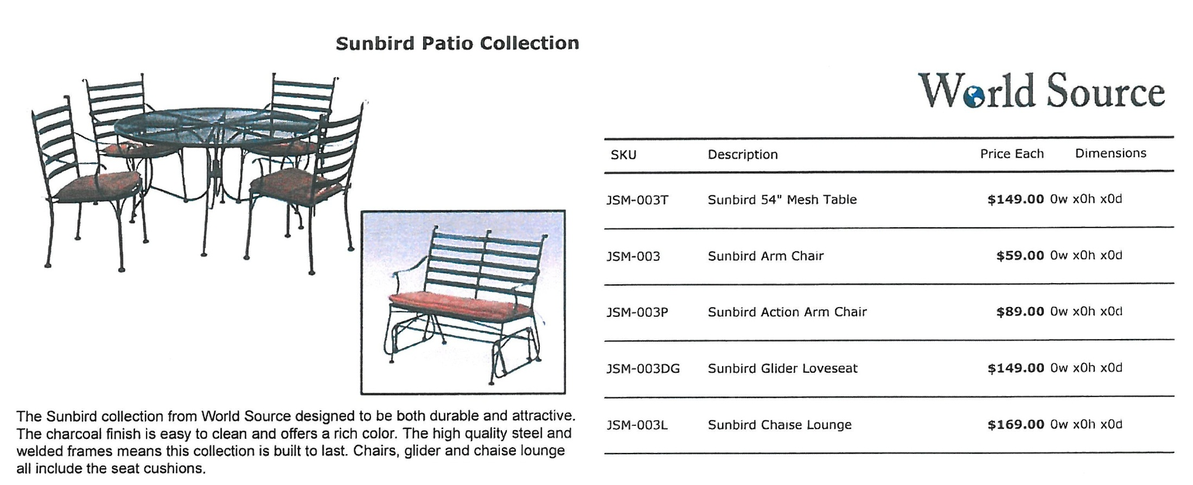

Slide 46
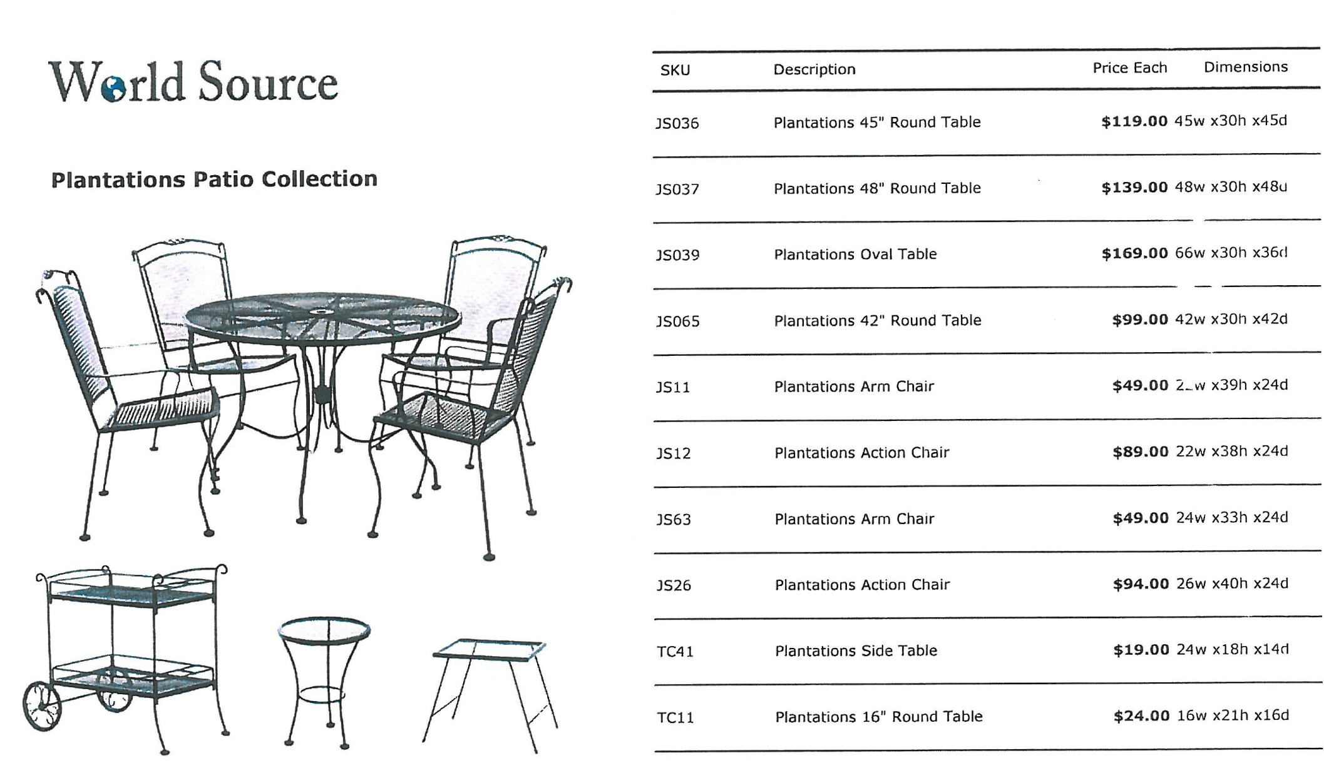

Slide 47
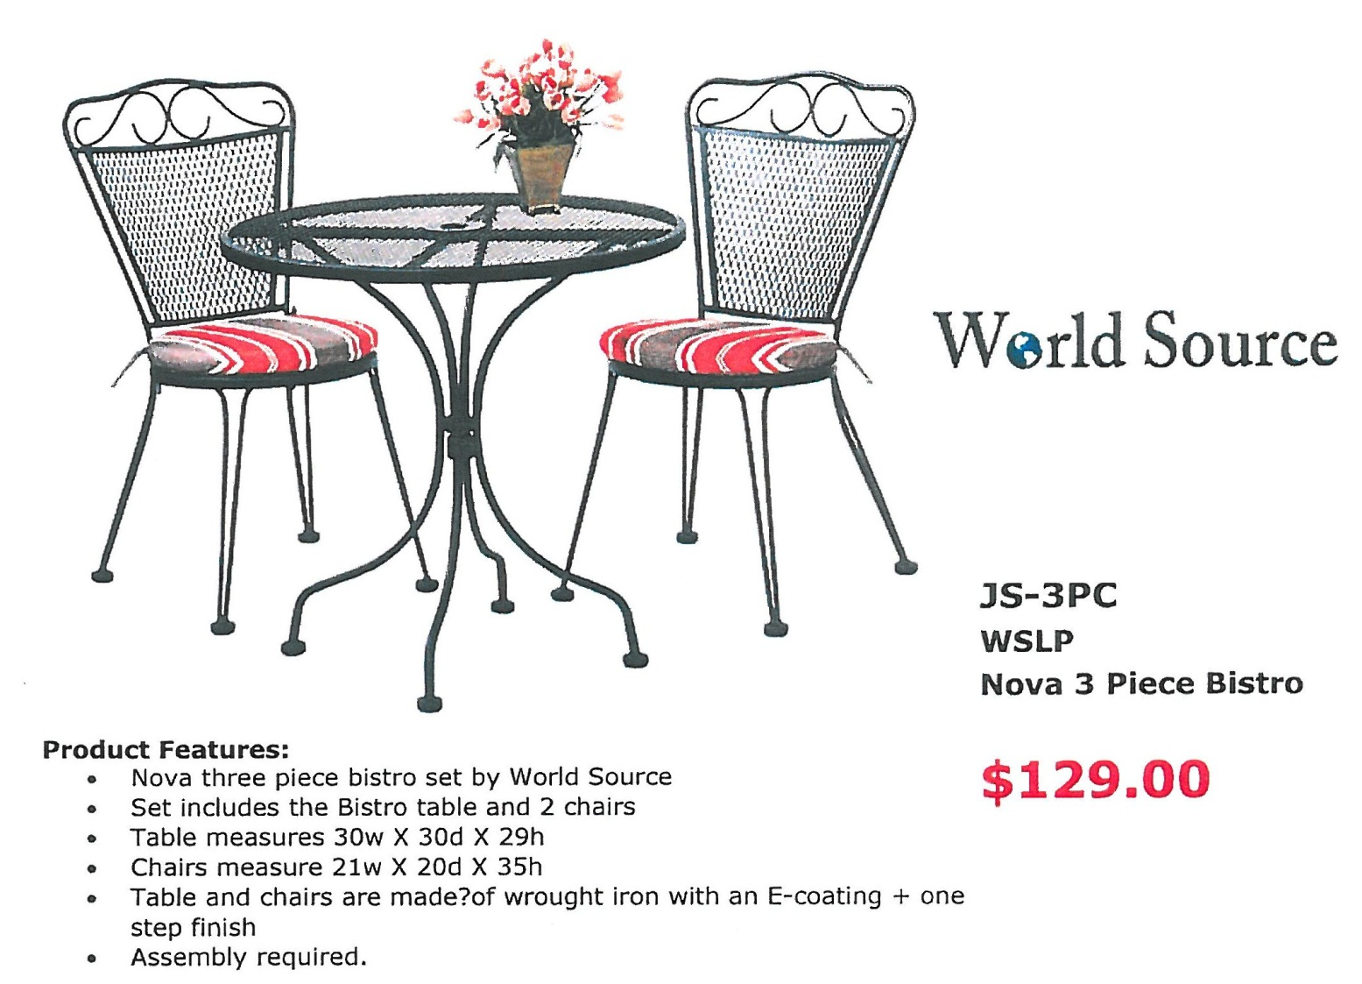

Slide 48
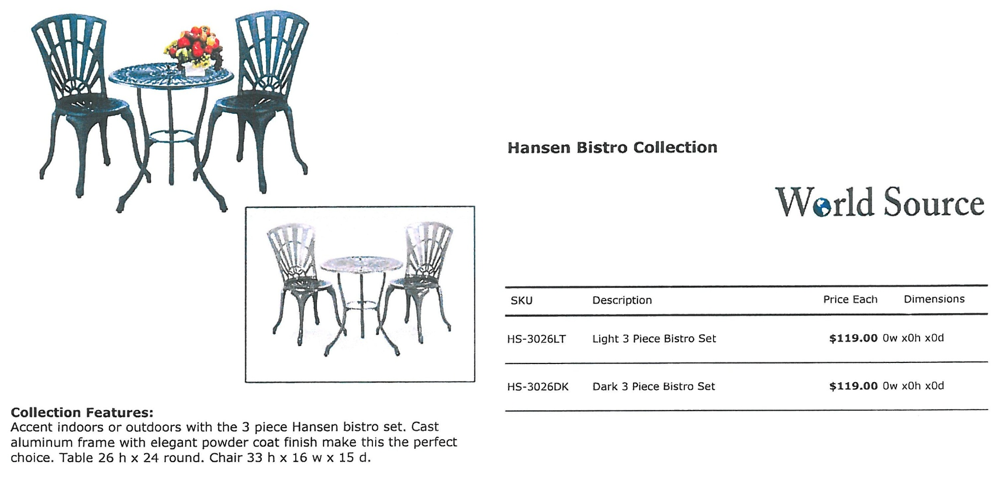

Slide 49
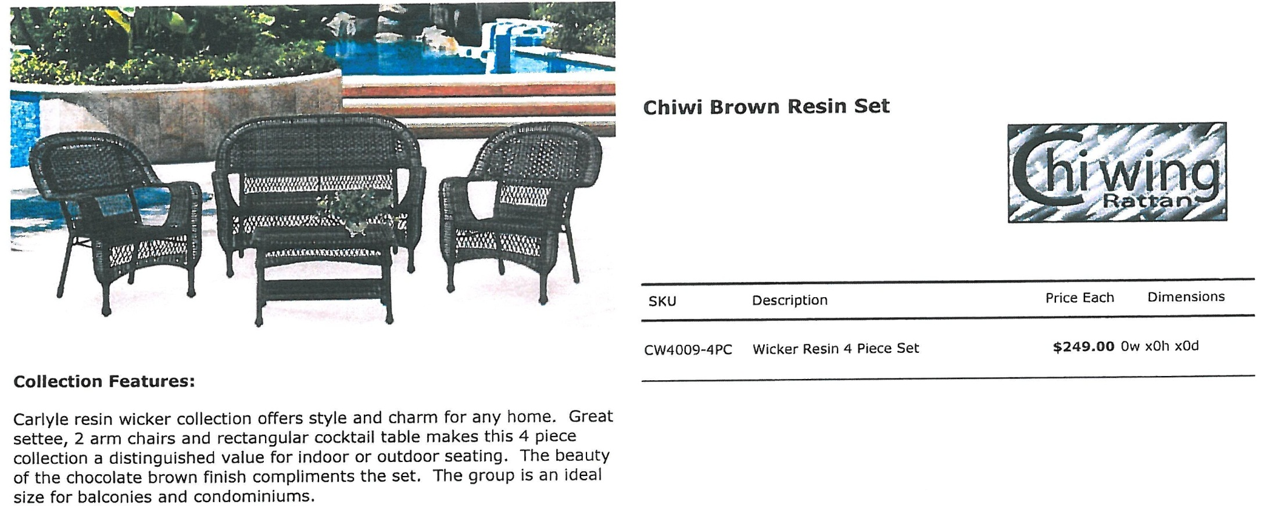

Slide 50
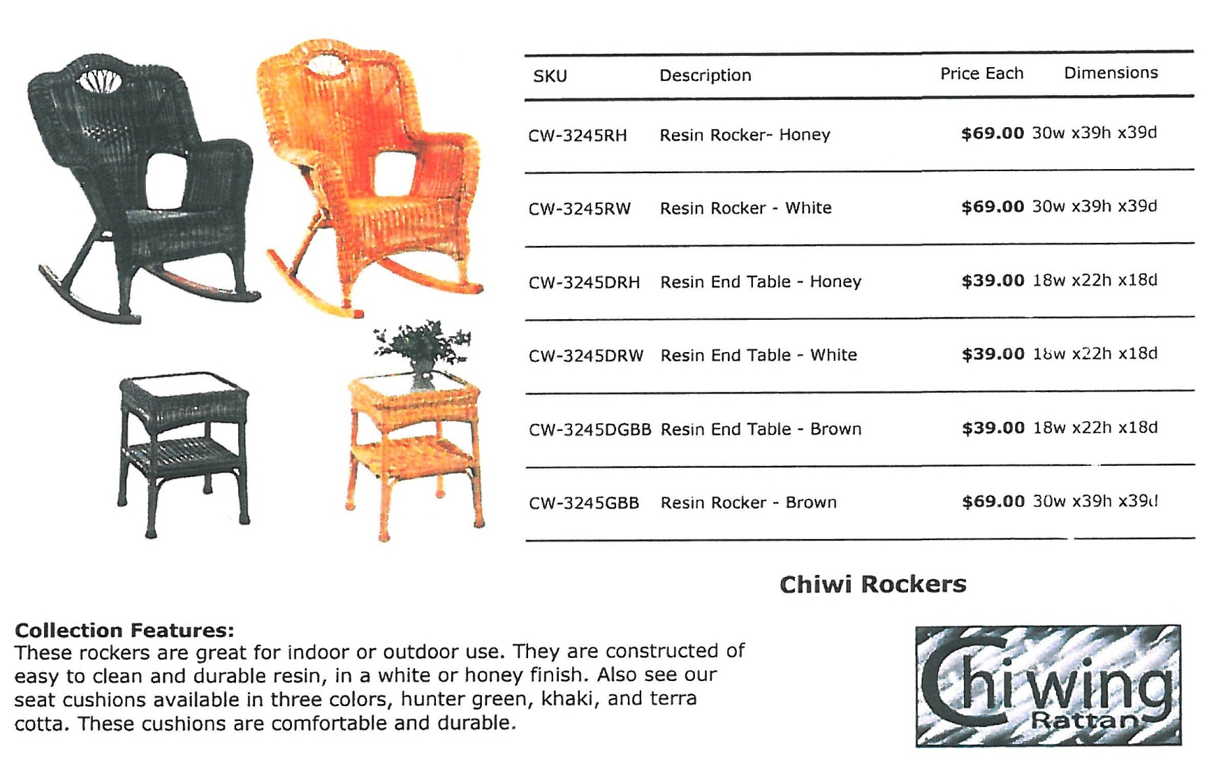

Slide 51
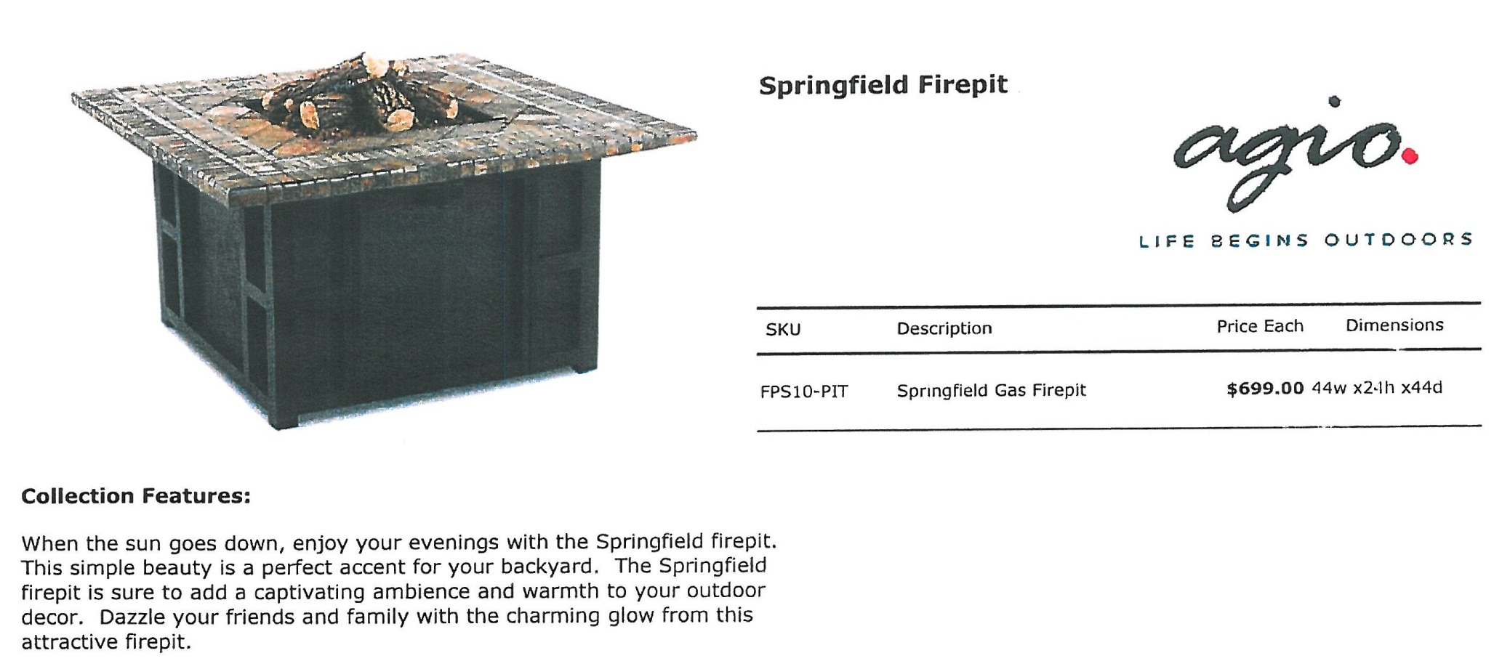

Slide 52
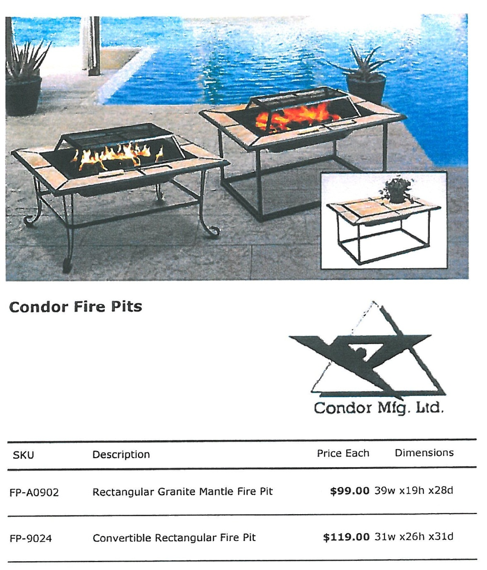

Slide 53
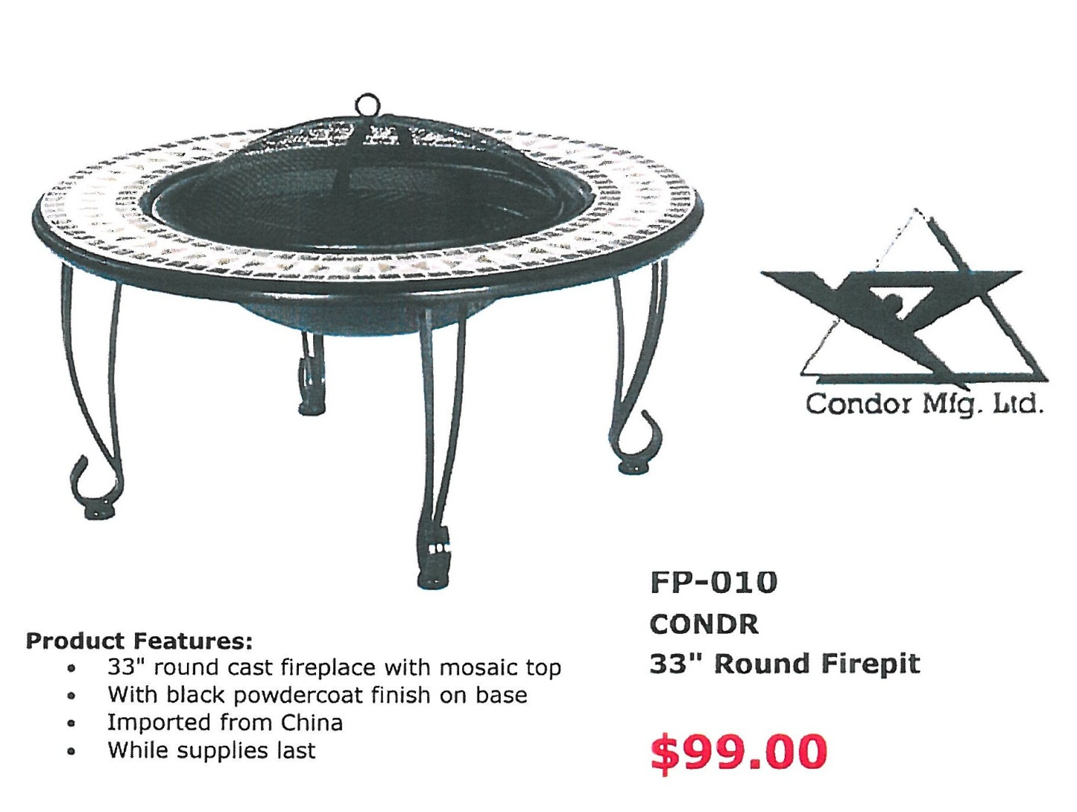

Slide 54
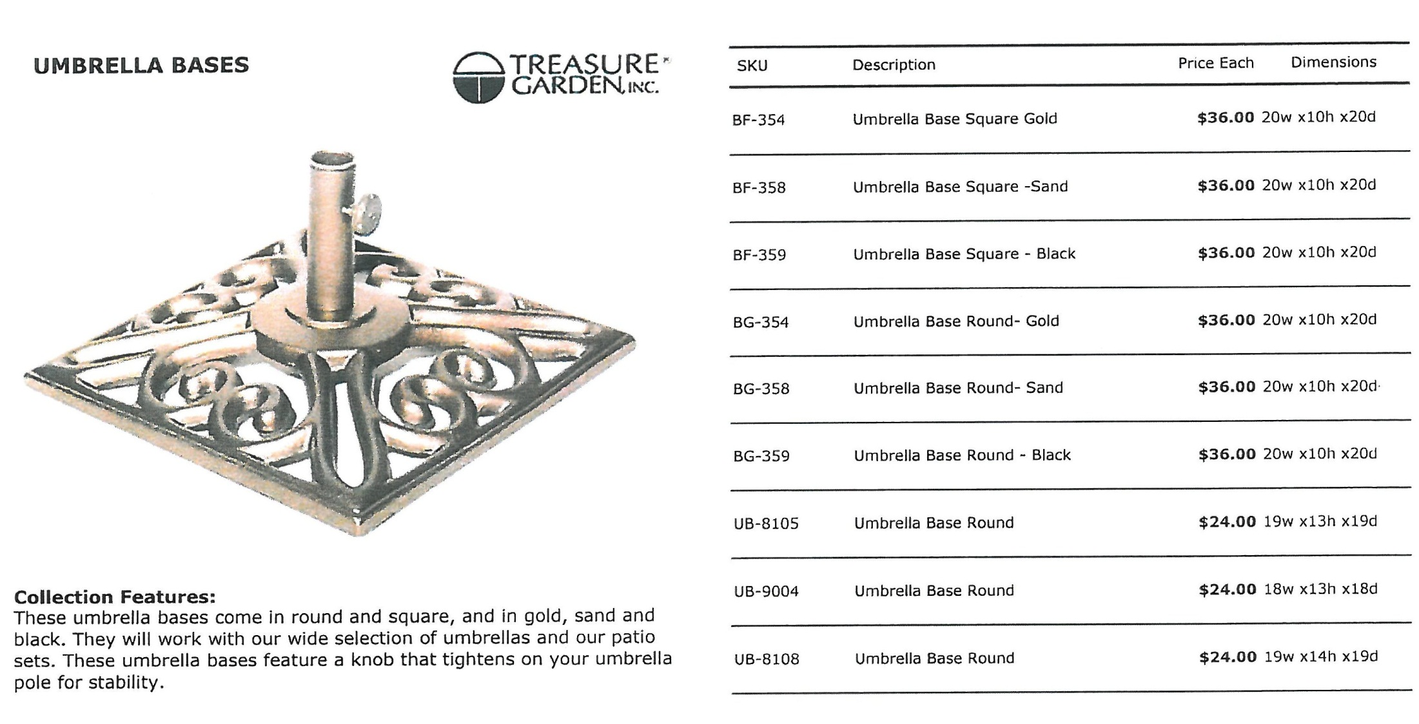

Slide 55


Slide 56


Slide 57


Slide 58


Slide 59


Slide 60


Slide 61


Slide 62


Slide 63


Slide 65


Slide 66






Slide 67






Slide 68





Slide 69


Slide 70


Slide 72

AGIO
Balcony Table and 2 Chairs
SKU# 29880267
Suggested Retail: $850.00
Sale Price: $329.99
You Save: $520.01 (61.18%)

Slide 73

CHI WING
Loveseat, 2 Chairs and Cocktail Table
SKU# 29882834
Suggested Retail: $590.00
Sale Price: $309.98
You Save: $280.02 (47.46%)

Slide 74

FOUR SEASONS
Table and 4 Chairs
SKU# 31417363
Suggested Retail: $440.00
Sale Price: $214.95
You Save: $225.05 (51.15%)

Slide 75

FOUR SEASONS
Table and 6 Chairs
SKU# 31417314
Suggested Retail: $1,000.00
Sale Price: $494.93
You Save: $505.07 (50.51%)
Steel Sling Spring Chair
60” x 38” Glass Dining Table

Slide 76

HOME STYLES
5 PIECE 42 OUTDOOR DINING SET
SKU# 31525637
Sale Price: $929.99
Home Styles 5PC Set includes 42" Round Outdoor Dining Table and Four Arm Chairs. Set is constructed of cast aluminum with a Rust bronze finish.

Slide 77

PRIDE
Table, 4 Dining and 2 Swivel Chairs
SKU# 31511447
Suggested Retail: $1,369.00
Sale Price: $729.93
You Save: $639.07 (46.68%)

Slide 78

TELESCOPE
Table, 2 Swivel & 2 Side Chairs
SKU# 31421043
Suggested Retail: $1,750.00
Sale Price: $1,069.95
You Save: $680.05 (38.86%)

Slide 79

TELESCOPE
Table, 2 Arm and 2 Swivel Chairs
SKU# 31420904
Suggested Retail: $4,310.00
Sale Price: $2,599.95
You Save: $1,710.05 (39.68%)

Slide 80

TELESCOPE
Table, 2 Swivel and 4 Arm Chairs
SKU# 31420524
Suggested Retail: $4,420.00
Sale Price: $2,699.93
You Save: $1,720.07 (38.92%)

Slide 81


WINSTON
Table with 2 Swivel and 4 Dining Chairs with Cushions
SKU# 31604648
Suggested Retail: $7,660.00
Sale Price: $4,469.87
You Save: $3,190.13 (41.65%)

Slide 82


WINSTON
Table with 2 Swivel and 2 Dining Chairs
SKU# 31604812
Suggested Retail: $4,690.00
Sale Price: $2,739.94
You Save: $1,950.06 (41.58%)

Slide 83

WINWARD DESIGN
Table, 2 Arm and 2 Swivel Chairs
SKU# 31604903
Suggested Retail: $1,340.00
Sale Price: $909.99
You Save: $430.01 (32.09%)

Slide 84

WOODARD
Table and 4 Chairs
SKU# 31811862
Sale Price: $1,769.94

Slide 85

WOODARD
Table and 4 Chairs
SKU# 31811904
Sale Price: $2,569.94

Slide 86


BOND MFG.
Cliffstone Fire Column
SKU# 31080658
Suggested Retail: $240.00
Sale Price: $159.99
You Save: $80.01 (33.34%)
BONG MFG.
Cliffstone Firebowl
SKU# 31080641
Suggested Retail: $590.00
Sale Price: $379.99
You Save: $210.01 (35.59%)

Slide 87


PARROT BAY
PREMIUM OUTDOOR TABLE LAMP
SKU# 30955553
Sale Price: $189.99
PARROT BAY
PREMIUM OUTDOOR FLOOR LAMP
SKU# 30955561
Sale Price: $319.99

Slide 90


Slide 91


Slide 92


Slide 93



Slide 94


Slide 96

Additional images on the next slide…
ROMA COLLECTION

Slide 97










Slide 98



BELLAGIO

Slide 99



STEEL / WOVEN
Sofa
Lounge Chair
Single Glider
Dining Chair
Love Seat
Double Glider
Swivel Glider
High Back Rocker
Ottoman
Side Table
Coffee Table

Slide 100





STEEL / WOVEN
Sofa- Kidney Shaped
Sofa
Love Seat
Double Glider
Swivel Glider Club Chair
Single Glider Club Chair
Rocker
Lounge Chair
Ottoman
Dining Chair
Double Chaise Lounge
Single Chaise Lounge
End Table
Coffee Table
Large Ottoman

Slide 101



STEEL / WOVEN
Sofa- 3 seat
Love Seat- 2 seat
Sofa Glider
Double Glicer
Lounge Chair
Dinning Chair
Rocker
Single Glider
Coffee Table- square
Swivel Glider Club
End Table
Coffee Table- oval
Single Adjustable Chaise
Chaise Lounge
Adjustable Chaise
Multi-adjustable Chaise

Slide 102



STEEL / WOVEN
Double Glider
Love Seat
Sofa
Chaise Lounge
Double Adjustable Chaise Lounge
Adjustable Chaise Lounge
Dining Chair
Lounge Chair
Rocker
Swivel Glider
Single Glider
Ottoman
End Table
Coffee Table

Slide 104


Slide 105


Slide 106


Slide 107


Slide 108


Slide 109


Slide 110


Slide 111


Slide 112


Slide 113


Slide 114


Slide 115


Slide 116


Slide 117


Slide 118



Slide 119


Slide 120


Slide 121


Slide 122


Slide 123



Slide 124


Slide 125


Slide 126


Slide 127


Slide 128


Slide 129





Slide 130



Slide 131


Slide 132


Slide 133



Slide 134


Slide 135


Slide 136


Slide 137


Slide 138


Slide 139


Slide 140


Slide 141


Slide 142


Slide 143


Slide 144


Slide 145


Slide 146


Slide 147


Slide 148


Slide 149


Slide 150


Slide 151


Slide 152


Slide 153


Slide 154


Slide 155


Slide 156


